Slide 1

Special Topics:
Water Oxidation Catalysis: Homogeneous or Heterogeneous?
Ulrich Hintermair, Staff Sheehan, Julie Thomsen
Crabtree & Brudvig Labs
Yale Chemistry

Slide 2
Water Oxidation
Methods Precipitation Control NP Synthesis Gelation Structure Function Additional Projects
Goal: 2H₂O → 2H₂ + O₂ Water Splitting
Two Half Reactions:
4H⁺ + 4e− → 2H₂ Reduction (lower activation barrier)
2H₂O → O₂ + 4H⁺ + 4e⁻ Oxidation (higher activation barrier)
Oxidant: CAN ceric ammonium nitrate (high oxidative potential)
NaIO₄ Sodium periodate (lower oxidative potential)
Catalyst: Ir^{III} → Ir^{IV}
Notes:
http://pubs.rsc.org/en/content/articlehtml/2012/cp/c2cp41490b
O-O difficult to form; requires more energy
Low activation barrier means low overpotential
Hydrogen as a clean energy carrier
C-H oxidation instead of water oxidation to obtain target chemicals → reduction reaction is what would make the fuels
Purpose of CH oxidation is for taking C-H to C-O (mainly for specialty chemicals – decalin and THF oxidation)
CH oxidation and reduction in concert – methanol splitting for energy in fuel cells (DMFC)

Slide 3
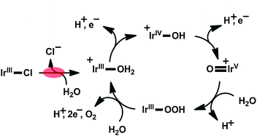
Oxidation Catalysis
Methods Precipitation Control NP Synthesis Gelation Structure Function Additional Projects
Platinum: acid stable; not very active
Ruthenium: active; not acid stable
Iridium: active & active stable
Garand E, et. al. Phys Chem Chem Phys 14 10109 (2012).
Notes:
Google images “water oxidation catalyst iridium”
Iridium molecular compound with bound chlorine – chloride pops off and gets oxidized also
Periodate grabs electrons – driving force to pull electrons out of iridium; periodate doesn’t get regernerated; gets consumed
Iridium loses 4 electrons to periodate and oxygen from water regernerates the catalyst
Rapidly exchanging weakly bound water; slowest process is OO bond formation ; step before –OOH is rate limiting step; on order of Hz
8 molecules oxygen atom per iridium per second; with dimer catalyst bound to surface (ITO)

Slide 4
Iridium Precursors
Methods Precipitation Control NP Synthesis Gelation Structure Function Additional Projects
Cp* = pentamethylcyclopentadienyl
Various ligands: tune properties of molecular materials; tune activity
Notes:
(in general ligands tune selectivity and mechanism but most importantly here is activity)

Slide 5
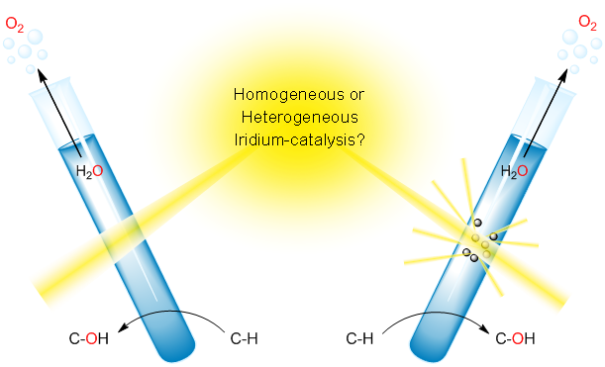
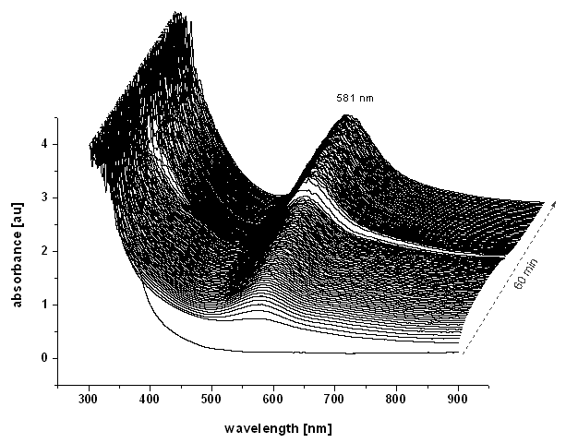
Iridium Catalysis
Methods Precipitation Control NP Synthesis Gelation Structure Function Additional Projects
Blue Solution develops during oxidation reaction
UV-vis measurements
Hintermair U, et. al. JACS 134 9785 (2012).

Slide 6
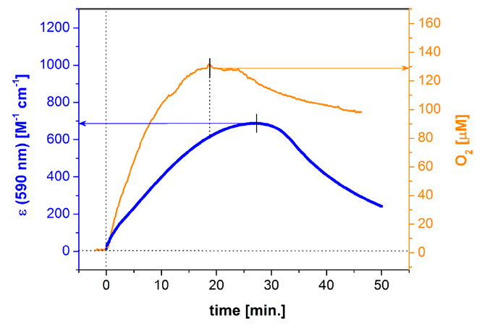
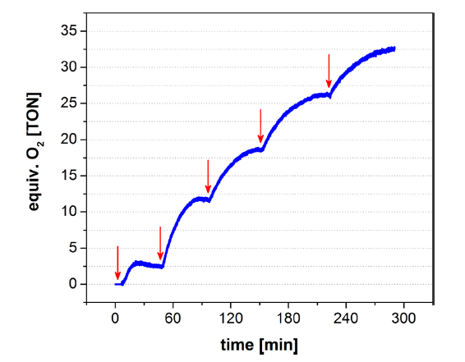
Reaction Assessed by Oxygen Generation
Methods Precipitation Control NP Synthesis Gelation Structure Function Additional Projects
Oxygen generated at same time as formation of blue band; oxidant gets consumed
Hintermair U, et. al. JACS 135 10837 (2013).

Slide 7
If the ligands are stable against oxidation…
Methods Precipitation Control NP Synthesis Gelation Structure Function Additional Projects
No light scattering… no particles…
→ Homogeneous catalysis
Hintermair U, et. al. JACS 134 9785 (2012).

Slide 8
If the ligands are oxidized…
Methods Precipitation Control NP Synthesis Gelation Structure Function Additional Projects
Particles!
→ Heterogeneous catalysis
Hintermair U, et. al. JACS 134 9785 (2012).

Slide 9
Concentration limits growth dynamics
Methods Precipitation Control NP Synthesis Gelation Structure Function Additional Projects
150 equivalents NaIO₄
75 equivalents NaIO₄
Particle Formation Reaction Kinetics
Notes:
First order reaction

Slide 10
Metal Oxide Particle Synthesis
Methods Precipitation Control NP Synthesis Gelation Structure Function Additional Projects
Aggregation is diffusion controlled
Power law dynamics in aggregate growth

Slide 11
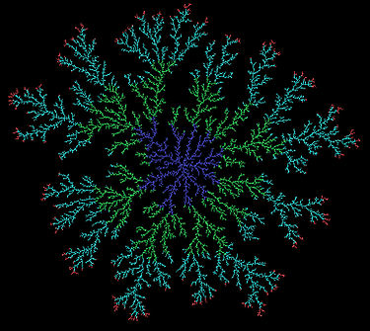
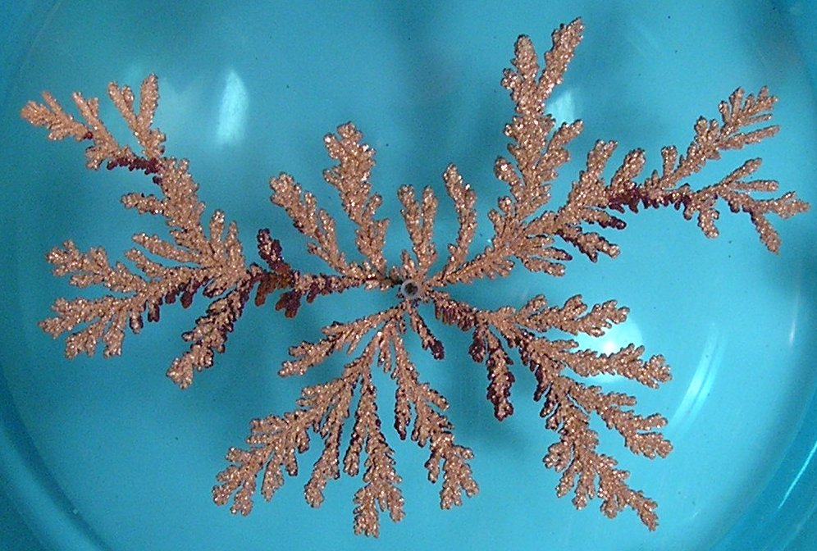
Diffusion limited aggregation
Methods Precipitation Control NP Synthesis Gelation Structure Function Additional Projects
Particles stick on first contact
In contrast to reaction limited aggregation, where sticking probability < 1 due to reaction energy barrier
Electrodeposited copper sulfate
Computer simulation

Slide 12
Aggregate Characterization
Methods Precipitation Control NP Synthesis Gelation Structure Function Additional Projects
Feature at ~30 nm: primary particle size
-2
Over time D_{f} evolves to ~2
Suspension forms
Solution only
Notes:
Persistent feature at ~30 nm: primary particle size

Slide 13
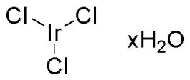
“Green” Metal Oxide NP Synthesis
Methods Precipitation Control NP Synthesis Gelation Structure Function Additional Projects
Aqueous, room temperature
Simplest precursor (off-the-shelf)
(in preparation)

Slide 14
Suspension Stability
Methods Precipitation Control NP Synthesis Gelation Structure Function Additional Projects
Scattered Intensity (magnitude only vs. time)
  Aggregation/sedimentation over time
  Addition of salts/surfactants can affect stability
Sedimentation
Growth

