Slide 1


Environmental Nanomaterial Dynamics:
Bridging Length Scales
786
Sara M. Hashmi, Ph.D.
Director, Facility for Light Scattering

Slide 2
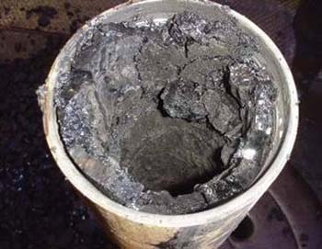
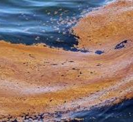
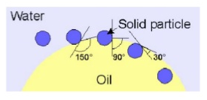
Asphaltenes
Most aromatic component of petroleum fluids
Industrial nuisance
Form pickering emulsions in oil spills
Fracking
water
photonics.com
Particle-stabilized droplets
Stable; difficult to separate
Notes:
Pickering emulsions – very stable, difficult to separate

Slide 3
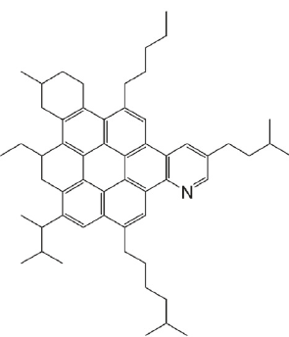
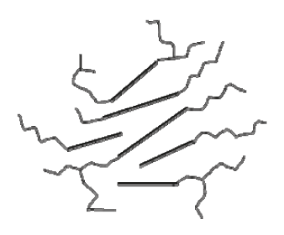
Asphaltene precipitation
Induced by pressure; temperature; composition
Colloid growth & aggregation
Cascading length scales
µm
Highly aromatic crude components
Liquid-liquid separation
o
A
Sedimentation & deposition
nm
π-stack even when stable
photonics.com
Notes:
More aromatics entrained, not heptane for instance

Slide 4
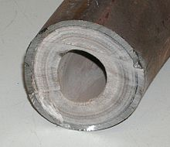
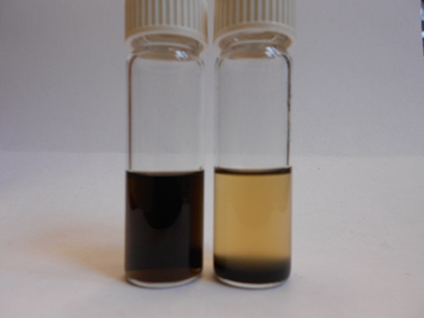
Molecules
Å → nm
Nanoparticles
Suspensions
nm → μm
mm → cm
Macroscale Flows
mm → cm → m

Slide 5
Molecules
Å → nm
Nanoparticles
Suspensions
nm → μm
mm → cm
Macroscale Flows
mm → cm → m

Slide 6
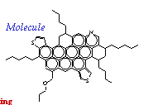
Asphaltene chemistry
Molecular Assembly Nanoparticle Interactions Bulk Sedimentation Deposition & Transport
Most aromatic; highest MW; may contain metals
Operational definition only:
  Soluble in toluene, aromatic solvents
  Insoluble in heptane, medium chain alkanes
No precise chemical formula
unit.aist.go.jp
Mullins, O. C. Energy & Fuels 24 2179 (2010).
Notes:
http://en.wikipedia.org/wiki/Petroleum
unit.aist.go.jp/energy/afg/asphaltene/Chapter1.htm

Slide 7
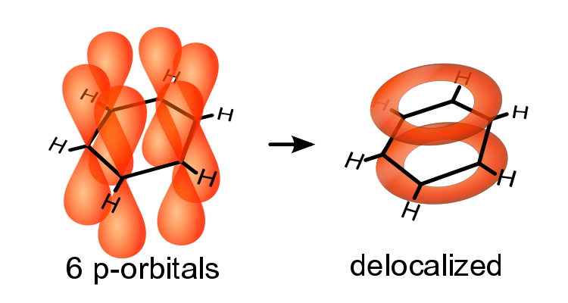
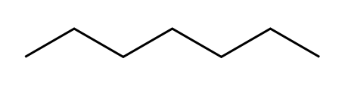
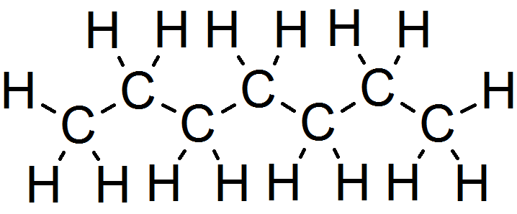
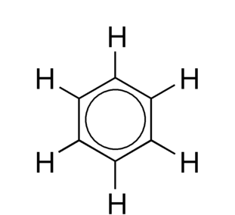
Importance of Aromaticity
Molecular Assembly Nanoparticle Interactions Bulk Sedimentation Deposition & Transport
Alkanes: non-polar
Bound electrons
Delocalized electrons
Aromatics: polar
Asphaltene
Mixing is unfavorable for large aromatic molecules

Slide 8
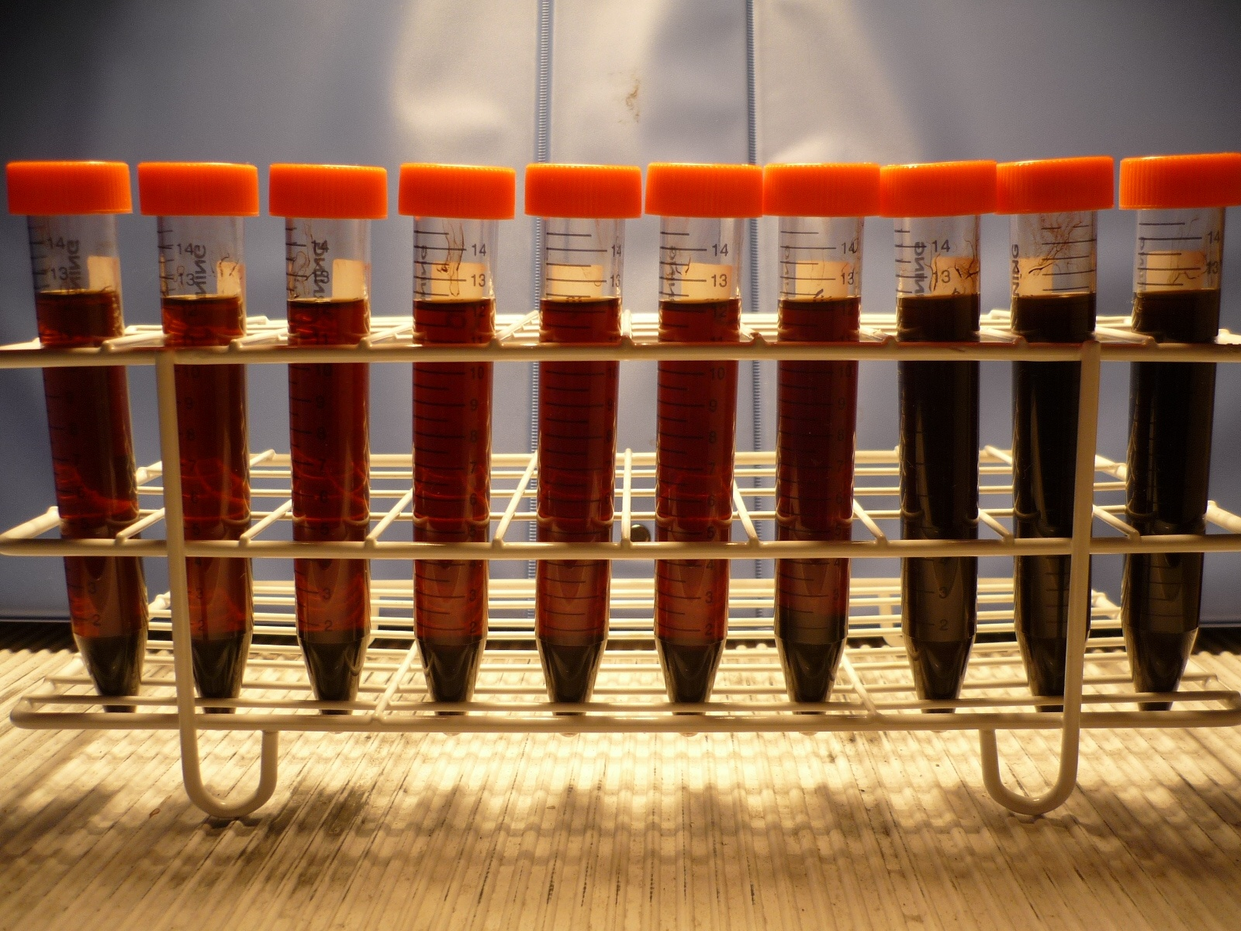
Experimental systems: purely organic
Molecular Assembly Nanoparticle Interactions Bulk Sedimentation Deposition & Transport
  1. Petroleum Fluid: BAB, SB, QAB, M2, CV
  2. Precipitant: heptane
  3. Dispersants: BA, 4F, DBSA
Materials
Mix components, allow precipitation, assess surfactant effects
Petroleum fluid ρ_{o} (g/mL) f(g/g)
BAB
SB
QAB
M2
CV
0.841
0.844
0.865
0.867
0.905
0.0031
0.0069
0.0125
0.0351
0.1180
Notes:
NOTE: error bars on f and pa very small (10^-5 or less) for QAB and CV

Slide 9
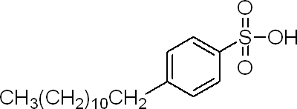
Surfactant Options
Molecular Assembly Nanoparticle Interactions Bulk Sedimentation Deposition & Transport
Name MW Type Molecular Structure
BA*
4F*
DBSA
2000
4000
322
Non-ionic
Non-ionic
Anionic
Polyolefin alkeneamine
Alkylated phenol
Known
* proprietary (Lubrizol)
Ionic headgroup
Dodecylbenzenesulfonic acid
DBSA = strong organic acid
Hydrophobic tail
Aromatic ring

Slide 10

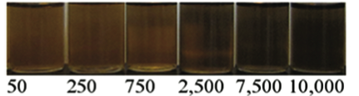
Dissolution by solvent or surfactant
Molecular Assembly Nanoparticle Interactions Bulk Sedimentation Deposition & Transport
Toluene: 3 17 30 46 60 80 100 wt. %
fully dissolved
fully dissolved
DBSA: 50 250 750 2,500 7,500 10,000 ppm
Color change indicates chemical reactions

Slide 11
Understanding Molecular Chemistry
Molecular Assembly Nanoparticle Interactions Bulk Sedimentation Deposition & Transport
c (ppm)
UV-vis spectra
n→σ*, n→π* transitions
Same signature as protonating free electrons in single or double-bonds
Hashmi, et. al. Soft Matter (2012).
Ngamna et al. Langmuir 23, 8569-8574 (2007).

Slide 12
Suggested Protonation Mechanism
Molecular Assembly Nanoparticle Interactions Bulk Sedimentation Deposition & Transport
+
Very strong, stable ion pairing in oil
Low concentration DBSA
Hashmi, Zhong, Firoozabadi. Soft Matter (2012).

Slide 13
Suggested Protonation Mechanism
Molecular Assembly Nanoparticle Interactions Bulk Sedimentation Deposition & Transport
Higher concentration DBSA: Solvation shell
Due to high acidity of DBSA, need to rule out hydrolysis…
Hashmi, Zhong, Firoozabadi. Soft Matter (2012).

Slide 14
Reversibility of acid-base interactions
Molecular Assembly Nanoparticle Interactions Bulk Sedimentation Deposition & Transport
triethylamine; pKa~10.7
50,000 ppm = ~100 mM DBSA
~100 mM DBSA + ~100 mM TEA
TEA competes w/ heteroatomic asphaltene groups to ion-pair w/ DBSA;
Removal of non-polar DBSA tails from asphaltenes destabilizes them.
(Ulrich Hintermair, Yale Chemistry)

Slide 15
Molecules
Å → nm
Nanoparticles
Suspensions
nm → μm
mm → cm
Macroscale Flows
mm → cm → m

Slide 16
Particle characterization: Light scattering
Molecular Assembly Nanoparticle Interactions Bulk Sedimentation Deposition & Transport
Diffusing particles [nm – μm]
Incident light
Unperturbed light
Light scatters in all directions
Diffusion constant
Intensity at detector fluctuates due to particle motion → diffusive time scale
Thermal energy scale
Solvent viscosity
Particle size

Slide 17
Dispersants suppress growth
Molecular Assembly Nanoparticle Interactions Bulk Sedimentation Deposition & Transport
c (ppm)
Hashmi & Firoozabadi. Energy & Fuels (2012).
Notes:
ANIMATE CV χ=600 mL/g

Slide 18
Dispersants shrink nanoparticles
Molecular Assembly Nanoparticle Interactions Bulk Sedimentation Deposition & Transport
Similar behavior
Size decrease is limited

Slide 19
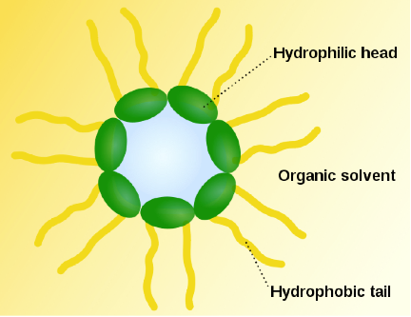
What differentiates surfactants?
Molecular Assembly Nanoparticle Interactions Bulk Sedimentation Deposition & Transport
Increasing concentration
Self-association leads to
reverse micelle formation
at critical micelle concentration
Measurable via:
conductivity, light scattering, surface tension, viscosity…

Slide 20
Dispersant critical micelle concentration
Molecular Assembly Nanoparticle Interactions Bulk Sedimentation Deposition & Transport
by conductivity measurements
BA ~ 10 ppm 4F ~ 100 ppm
Notes:
Fix the y axis negative exponents

Slide 21
Dispersant micellization
Molecular Assembly Nanoparticle Interactions Bulk Sedimentation Deposition & Transport
by conductivity measurements
BA ~ 10 ppm 4F ~ 100 ppm
Notes:
Fix the y axis negative exponents

Slide 22
Micellization explains the limit
Molecular Assembly Nanoparticle Interactions Bulk Sedimentation Deposition & Transport
Behavior collapses
But can adsorption alone induce interparticle repulsion?

Slide 23
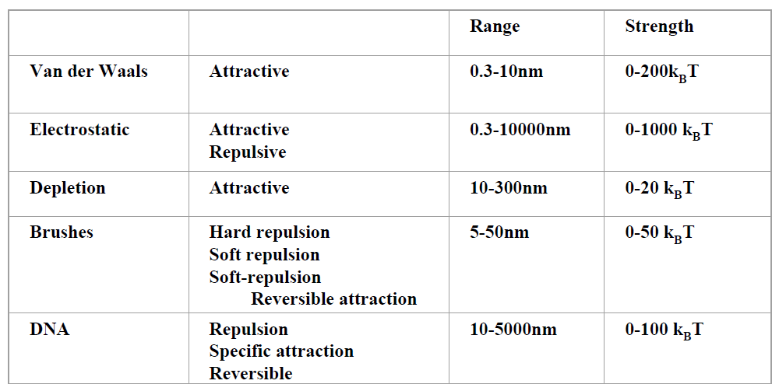
In/Stability & interparticle interactions
Molecular Assembly Nanoparticle Interactions Bulk Sedimentation Deposition & Transport
Universal
Repulsion Required
Brushes: short-ranged
Electrostatics: good candidate to explain stability
However, asphaltene suspensions are non-polar…
physics.nyu.edu/~pc86

Slide 24
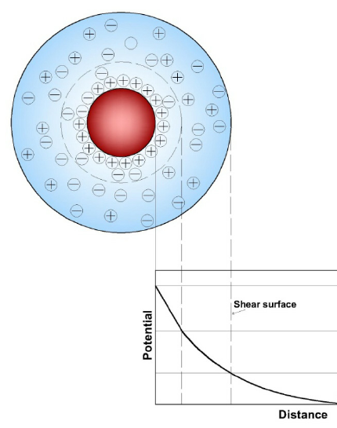
Electrostatics in Non-Polar Systems
Molecular Assembly Nanoparticle Interactions Bulk Sedimentation Deposition & Transport
-
Aqueous suspensions
Thin double layers
Double layer indicates range of electrostatic interactions
Non-polar suspensions
Thick double layers
Electrostatic attraction is longer range in oil than in water
Notes:
https://www.researchgate.net/publication/236186356_Iron_Oxide_Nanoadsorbents_for_Removal_of_Various_Pollutants_from_Wastewater_An_Overview

Slide 25
Measurement Concept: Zeta Potential
Molecular Assembly Nanoparticle Interactions Bulk Sedimentation Deposition & Transport
with electric field : diffusion with drift
+
Drift velocity:
-
Initial position
Diffusive trajectory
Final position
Surface charge
Balance electrostatic force:
Against hydrodynamic force:
Electrophoretic mobility:
Related to surface charge:
Notes:
Force balance is f=qE=QeE = f=6 pi*eta*a*v → QeE=6pi*eta*a*v → v/E = Qe/6pi*eta*a

Slide 26
Electrophoretic mobility at c=0 ppm
Molecular Assembly Nanoparticle Interactions Bulk Sedimentation Deposition & Transport
-
+
-
+
+
-
-
+
π electrons
metal ions
Hashmi, Firoozabadi. Soft Matter 8, 1878 (2012).
Notes:
Have checked this over a variety of conditions and several different asphaltene systems – it’s robust! Reason there is nothing near 0 is due simply to the resolution of the instrument

Slide 27
Dispersant increases surface charge
Molecular Assembly Nanoparticle Interactions Bulk Sedimentation Deposition & Transport
CV
QAB
SB
stable suspensions
cmc of BA in heptane
aggregation
Hashmi, Firoozabadi. Soft Matter 7, 8384 (2011).

Slide 28
Adsorption & electrostatic stabilization
Molecular Assembly Nanoparticle Interactions Bulk Sedimentation Deposition & Transport
Surfactant adsorption on particle surface prevents further growth and aggregation
unstable
stable

Slide 29
Molecules
Å → nm
Nanoparticles
Suspensions
nm → μm
mm → cm
Macroscale Flows
mm → cm → m

Slide 30
Controlling Sedimentation in Bulk
Molecular Assembly Nanoparticle Interactions Bulk Sedimentation Deposition & Transport
Mix with heptane to induce separation
→ FAST separation
GOAL: slow dynamics
  days or weeks
t=0 t=3 t=4 t=6 t=100 min
Hashmi & Firoozabadi J. Phys. Chem. B 114 15780 (2010).

Slide 31
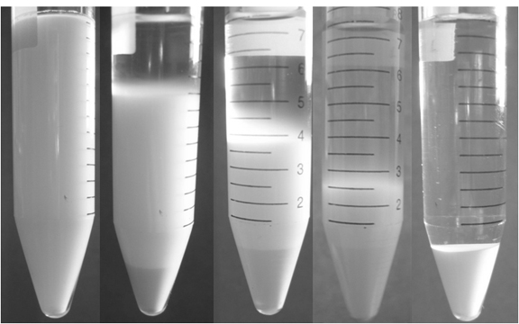
Hard sphere systems: linear front
Molecular Assembly Nanoparticle Interactions Bulk Sedimentation Deposition & Transport
1.57 µm radius silica spheres in water at Φ=0.05
t = 0 min t = 60 min t = 95 min t = 150 min t = 210 min
Notes:
Align pictures – P10805… 37, 52, 59, 641, 572

Slide 32
Hard sphere systems: linear front
Molecular Assembly Nanoparticle Interactions Bulk Sedimentation Deposition & Transport
Φ
a = 1.57 µm; silica particles in water
Sedimentation Velocity:
µm/s
Gravity
Density difference
Measured v ~ 2 to 3x slower than expected
Silica zeta potential:
ζ = -18.25 +/- 0.31 mV

Slide 33
Asphaltene sedimentation dynamics
Molecular Assembly Nanoparticle Interactions Bulk Sedimentation Deposition & Transport
Adding heptane lowers concentration, slows dynamics
M2; χ =40 (mL/g); c = 0 ppm
χ (mL/g)
SB; c = 0 ppm
Falling, compacting fronts
t=0 t=3 t=4 t=6 t=100 min
Hashmi & Firoozabadi J. Phys. Chem. B 114 15780 (2010).

Slide 34
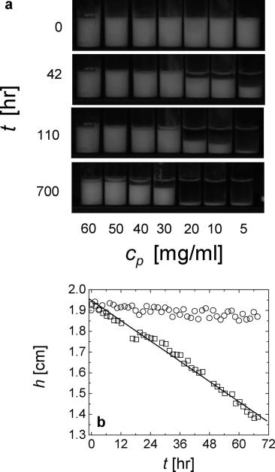
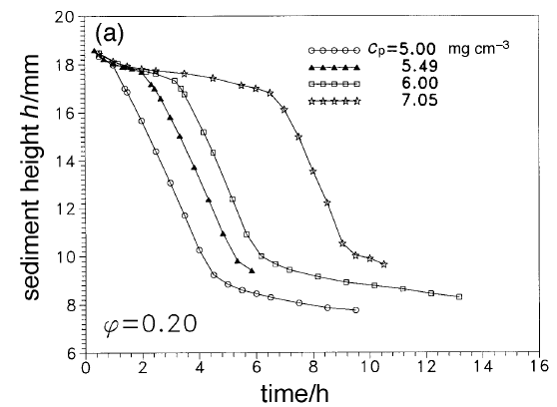
Gelling systems: sudden collapse
Molecular Assembly Nanoparticle Interactions Bulk Sedimentation Deposition & Transport
Poon et. al. Faraday Discuss. 112, 143 (1999).
Lietor-Santos et. al. Langmuir. 26(5), 3174 (2010).

Slide 35
Sedimentation of unstable particles
Molecular Assembly Nanoparticle Interactions Bulk Sedimentation Deposition & Transport
NP formation
Aggregation
FAST Sedimentation
FAST
Separation
Sedimentation speed ~ (aggregate size)²

Slide 36
Dispersants slow sedimentation
Molecular Assembly Nanoparticle Interactions Bulk Sedimentation Deposition & Transport
c (ppm)
Collapsing front disappears
Hashmi & Firoozabadi J. Phys. Chem. B 114 15780 (2010).

Slide 37
Stable particles slow aggregation
Molecular Assembly Nanoparticle Interactions Bulk Sedimentation Deposition & Transport
NP formation
Aggregation
SLOW Sedimentation
SLOW Separation
Sedimentation speed ~ (aggregate size)²

Slide 38
Molecules
Å → nm
Nanoparticles
Suspensions
nm → μm
mm → cm
Macroscale Flows
mm → cm → m

Slide 39
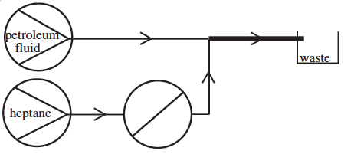
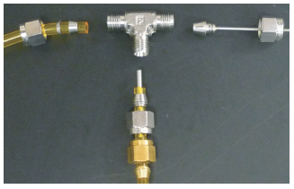
Application: Address Clogging
Molecular Assembly Nanoparticle Interactions Bulk Sedimentation Deposition & Transport
Mix with heptane to precipitate:
L >> R
Transducer
cm
cm
mL
Pipe Flow:
Nozzle for mixing
Pressure drop
Flow rate
Notes:
Viscosity = 33 cP; phi ~ 10% by weight

Slide 40
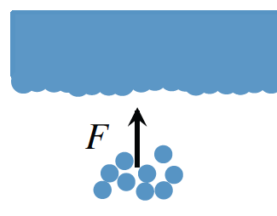
Convection-Diffusion
Molecular Assembly Nanoparticle Interactions Bulk Sedimentation Deposition & Transport
Deposition constricts pipe: requires higher pressure
R₀
R
Diffusive boundary layer: particles within the layer are prone to stick; particles beyond continue flowing
Hashmi et. al. Physics of Fluids (2015).

Slide 41
Dispersants reduce deposition
Molecular Assembly Nanoparticle Interactions Bulk Sedimentation Deposition & Transport
c (ppm)
Mixture C; Q = 4.2 mL/hr; Pipe 1;
Each trace is average of 5 runs
“Inhibition”
Parameter: changing particle size
Notes:
WHERE IS THE DATA PLOT SHOWING DECREASED DEPOSITION WITH BOTH BA AND DBSA???

Slide 42
Dispersants reduce deposition
Molecular Assembly Nanoparticle Interactions Bulk Sedimentation Deposition & Transport
More dispersant (c) → smaller particles → less clogging (ΔP)!
Notes:
WHERE IS THE DATA PLOT SHOWING DECREASED DEPOSITION WITH BOTH BA AND DBSA???

Slide 43
Dispersants reduce deposition
Molecular Assembly Nanoparticle Interactions Bulk Sedimentation Deposition & Transport
Destabilized asphaltenes deposit on the metal pipe
Without dispersant
Charge-stabilized colloids flow rather than stick
With dispersant
Some degree of prevention…Can we remove the deposit…?
Notes:
WHERE IS THE DATA PLOT SHOWING DECREASED DEPOSITION WITH BOTH BA AND DBSA???

Slide 44
Deposition Run Followed by Removal
Molecular Assembly Nanoparticle Interactions Bulk Sedimentation Deposition & Transport
Deposition run: Mixture C
Time = 0 signifies start of removal run
Example: removal run is CVA with DBSA
Impedance mismatch:
change between deposition & removal

Slide 45
Removal by 5% DBSA in CVA
Molecular Assembly Nanoparticle Interactions Bulk Sedimentation Deposition & Transport
Q (mL/min)
Fastest flow rate seems most effective: shear effects

Slide 46
Comparison DBSA & toluene
Molecular Assembly Nanoparticle Interactions Bulk Sedimentation Deposition & Transport
5% DBSA as effective as 50% toluene!
composition
Removal at < 0.2 PV suggests
Hashmi et. al. SPE Journal (2015).

Slide 47
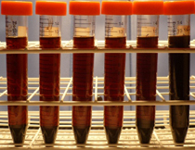
Importance of the nanoscale
Bulk sedimentation: controlled by
controlled by
Visible
Separation
Nanoparticle stability: in turn controlled by
Microscopic
instability
Molecular considerations
+
+
+
+
Stabilizing
repulsion
+
+
+
+
+
+

Slide 48
Conclusions
+
+
+
+
Stabilizing
repulsion
+
+
+
+
+
+
Strong organic acid creates molecular assemblies with asphaltenes
Non-ionic (proprietary) surfactants adsorb to asphaltenes, facilitate electrostatic colloidal stabilization
Macroscopic deposition & sedimentation can be controlled by understanding surfactant mechanisms employed on molecular & colloidal scale

Slide 49
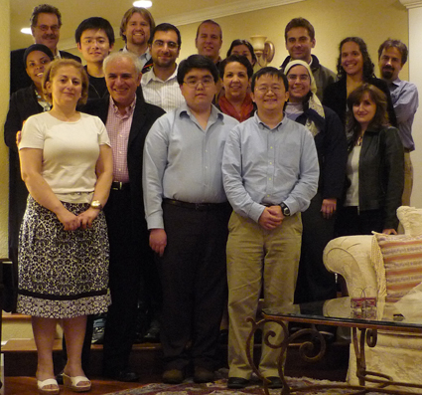
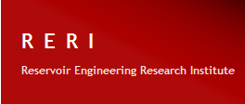
Acknowledgments
Abbas Firoozabadi, Yale/RERI
Michael Loewenberg, Yale
Menachem Elimelech, Yale
Eric Dufresne, ETH Zurich
Ian Morrison, Harvard
Sven Behrens, GA Tech
Ulrich Hintermair, Bath
Undergraduate Assistants
Leah Quintiliano, Kathy Zhong, Salvatore DeLucia, John Wolff, Batsi Swiswa, Hua Wang, Anjali Khetan
May 2009
Chevron ~ Maersk ~ ADCO ~ Pemex ~ Lubrizol

