Slide 1
Suspended Nanomaterials
786

Slide 2
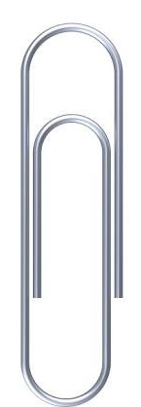
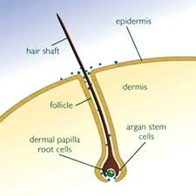
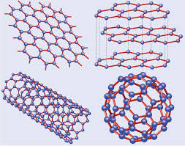
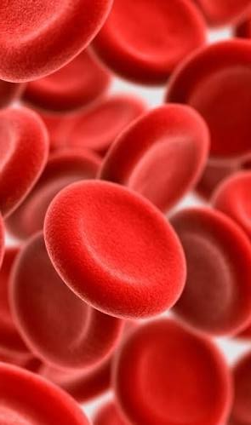
Nanomaterials & Colloids: How small?
~1 nm
~5 um
~50 um
~1 cm
nm (10⁻⁹m) um (10⁻⁶m) mm (10⁻³m) cm (10⁻²m)
← Atoms macroscopic →
Notes:
Klip - Rambut – darah

Slide 3
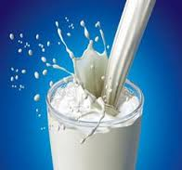
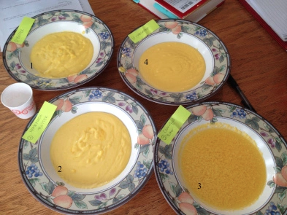
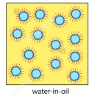
Emulsions
Notes:
Complex fluids in daily life
Emulsion – hollandaise sauce with different types of butter as fat; other ingredients – lemon juice and egg yolks
Dispersion -- paint
Foam

Slide 4
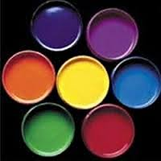
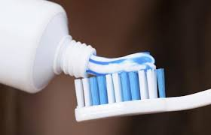
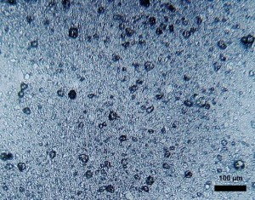
Suspensions
Notes:
Complex fluids in daily life
Emulsion – hollandaise sauce with different types of butter as fat; other ingredients – lemon juice and egg yolks
Dispersion -- paint
Foam

Slide 5

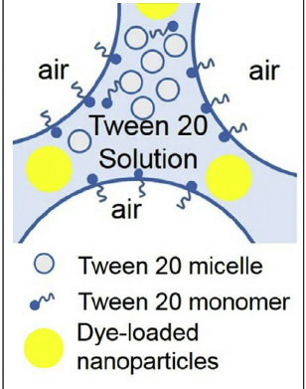
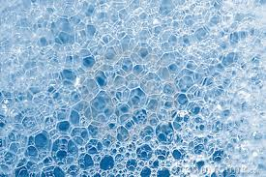
Foams
Tang et. al. Colloids & Surfaces 2015
Notes:
Complex fluids in daily life
Emulsion – hollandaise sauce with different types of butter as fat; other ingredients – lemon juice and egg yolks
Dispersion -- paint
Foam

Slide 6
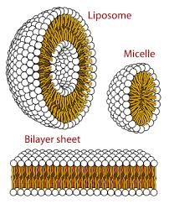
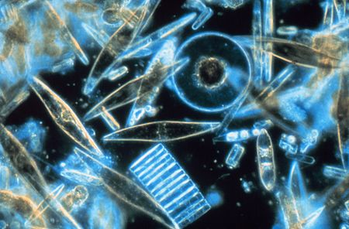
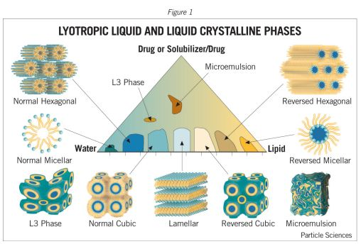
Biomaterials, Polymers, Liquid Crystals
Notes:
Diatoms lipid bilayers bacteria

Slide 7

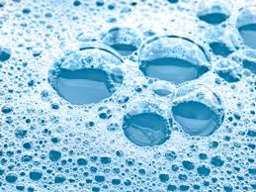
Complex Fluids ~ Soft Materials
  Solids dispersed in liquid SUSPENSION
  Liquid dispersed in liquid EMULSION
  Gas dispersed in liquid FOAM
  Polymers, surfactants
Mesoscopic length scales determine macroscopic phenomena

Slide 8
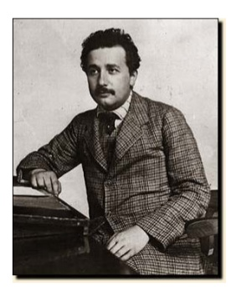
Some History…
1905: Einstein’s “Miraculous Year”
4 landmark papers
  E=mc²
  Theory of relativity
  Photoelectric effect
    (quanta of light)
  Described Brownian motion
  based on Kinetic theory of heat
Nobel Prize in 1921

Slide 9
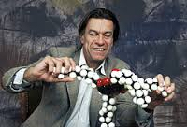
Some History…
Pierre de Gennes (1932-2007)
  “Founding father of soft matter physics”
  Nobel Prize in 1991
  “for methods developed for studying order phenomena in simple systems can be generalized to more complex forms of matter, in particular to liquid crystals and polymers”

Slide 10
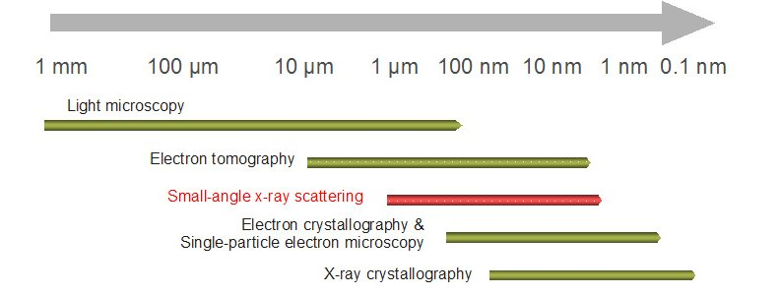
Characterizing Different Length Scales
Microscopy
  Optical
  Electron
Scattering
  Neutrons
  X-rays
  Light
Notes:
http://www.mdpi.com/2308-3425/2/2/125/htm
http://www.mlz-garching.de/englisch/neutron-research/experimental-methods/elastic-scattering.html
https://en.wikipedia.org/wiki/Biological_small-angle_scattering

Slide 11
Characterization by Waves
Light is an Electromagnetic field
Characterized by wavelength, frequency, phase
Interaction with materials
  Absorption
  Reflection
  Flourescence/luminescence
  Scattering
  Transmission

Slide 12
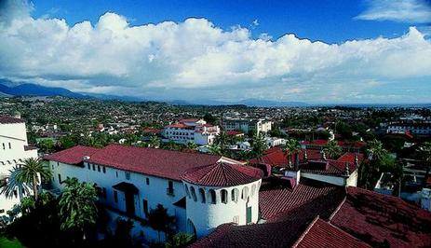
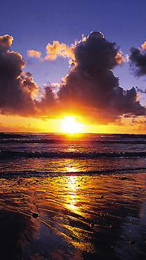
We all experience light scattering…
…from small particles… in nature:
Why is the sky blue…? And the sunset red…?
Notes:
Rayleigh Scattering

Slide 13
Mie vs. Rayleigh Scattering
Mie
  Particle size larger than wavelength of light
  Multiple photon scattering
Rayleigh
  Particle size smaller than wavelength of light
  Single photon scattering
  Atmospheric particles are comparable to
  Shorter wavelengths (blue) scattered more strongly than longer wavelengths (red)

Slide 14
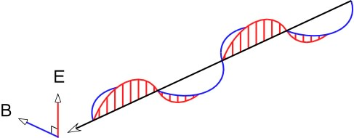
Light and its properties
Light is an oscillating wave of electric and magnetic fields
Characterized by frequency, wavelength and phase
Polarization: direction
of electric field oscillation
Intensity:
Notes:
Notes: Between 1864 and 1873, James Clerk Maxwell developed the theoretical description of electricity and magnetism. His results lead to the marvelous prediction that light is electromagnetic radiation propagating through free space in the form of orthogonal, oscillating electric and magnetic fields.
Maxwell’s description explains many of the important properties of light. For example, light is often linearly polarized. The polarization of the light is determined by the direction of oscillation of the electric field. Scattered and reflected light is often polarized, as can be readily tested with a pair of polaroid sunglasses. Look at the variation of the intensity of skylight or light reflected from a puddle as you rotate the glasses!
The measurable quantity of light is the intensity, which is proportional to the square of the electric field magnitude, i.e., . The intensity is a measure of the power imparted by the light on a given area.
Key Ideas:
electric field - Light consists of oscillating electric and magnetic fields. The electric field interacts more strongly with matter than the magnetic field.
linear polarization - The direction of oscillation of the electric field.
intensity - The observable quantity of the light, i.e., the power imparted by the light on a given area. The intensity is proportional to the square magnitude of the electric field.

Slide 15
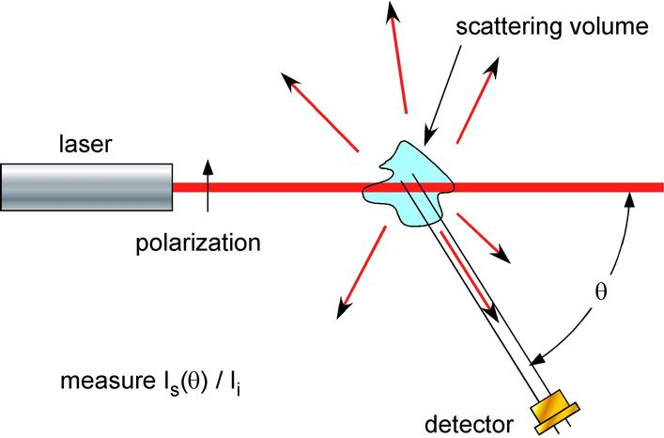
Generic Light Scattering Setup

Slide 16
What Can LS Measure?
By investigating pattern of scattered light
  Molar mass, M
  Radius of gyration r_{g}
  Second virial coefficient, A₂ (interaction potential)
  Aggregate shapes & structures
Intensity
1/Angle

Slide 17
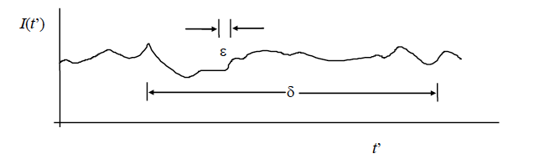
What Can LS Measure?
By investigating dynamics of scattered light
  Translational/rotational diffusion coefficient
  Hydrodynamic radius & polydispersity (fast dynamics)
  Aggregation & sedimentation (slow dynamics)
Intensity
Time

Slide 18
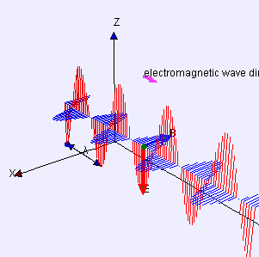
Polarized light
Incident laser light is polarized
Scattering from non-spherical particles alters polarization of the light

Slide 19
What Can DLS Measure?
Hydrodynamic Sizes
Size Distributions
Aggregation Rates
Critical Micelle Concentration
DLS reveals Brownian motion of a certain size range
532 nm
Types of Materials: suspensions, emulsions, microemulsions, polymers, micelles
90⁰

