Slide 1
DLS Basics
786

Slide 2
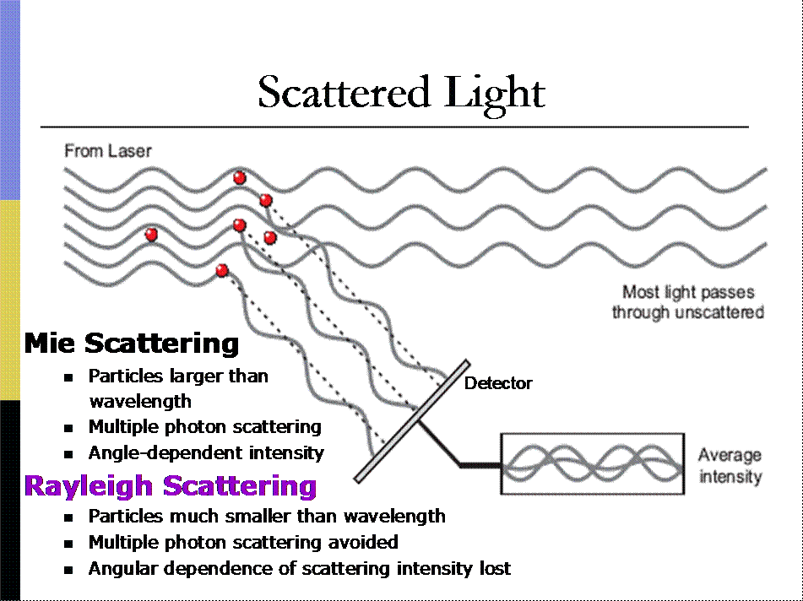
Dynamic Light Scattering: Setup
Incident light
Diffusing colloids
Transmitted light
Scattering angle
Light scatters in all directions
Detector
Fluctuating scattered light intensity
Fluctuations in scattered light arise from diffusion
Notes:
http://www.people.vcu.edu/~ecarpenter2/DigitalCorrelator.htm

Slide 3
Scattered Light Intensity: t = 0
Particles in fixed positions
Incident light
Unperturbed light
If particles remain fixed, so does intensity at detector
Detector
I = I₀
Static scattering reveals micro-structure; e.g. x-ray crystallography

Slide 4
Scattered Light Intensity: t = Δt
Particles have diffused
Incident light
Unperturbed light
If particles move, intensity at detector changes
Detector
I = I(Δt) = I₀
Duration of Δt before intensity changes gives time scale of motion
Dynamic light scattering reveals ensemble average motion
Notes:
Particle motion causes intensity change at detector

Slide 5
Signal fluctuates in time
How fast? Over what time scale?
Instrument calculates correlation function:

Slide 6
Compare the signal I to itself:
.…
Lag time:
If: , then is large
As: , then diminishes

Slide 7
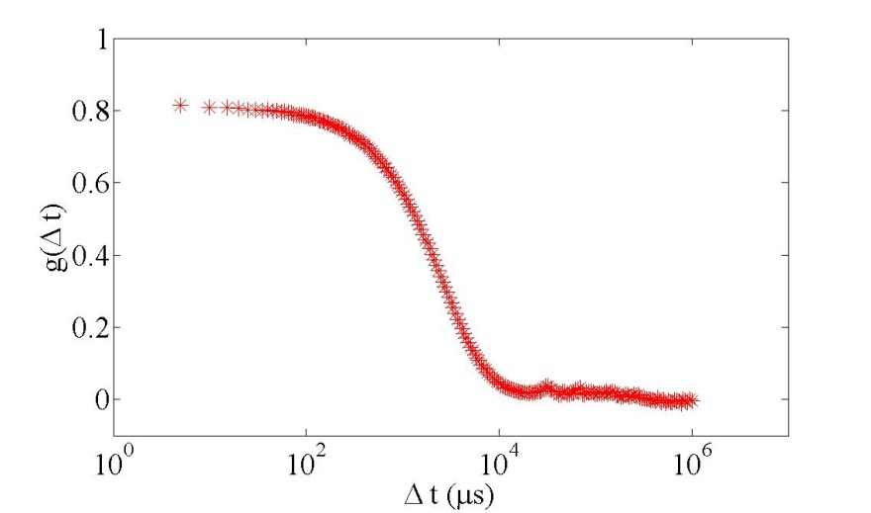
What does the correlation G look like?
Siegert approximation
Where
Raw data:
exponential decay
Thought experiment: if this is an example correlation function for a randomly fluctuating signal I, what would the correlation function look like if the signal I was sinusoidal? Otherwise periodic?

Slide 8
Meaning of decay time-scale
Fluctuations in scattered light arise from diffusive motion
Correlation function of scattered light intensity: exponential decay
Detector
Real-time hardware correlators measure
lag time Δt at which
I(Δt) = I₀
Notes:
http://www.people.vcu.edu/~ecarpenter2/DigitalCorrelator.htm

Slide 9
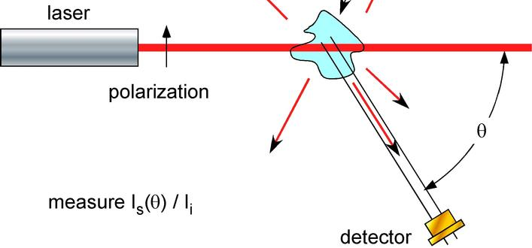
From time-scale to size scale
Units of Diffusion = [length²/time]
Length scale given by scattering vector q
q has units 1/length; can be controlled by adjusting θ
Diffusion through area 1/q² occurs at time scale τ

Slide 10
Measured Diffusion Constant
Diffusion D has units length²/time
Time is τ, as obtained through exponential fit
Length scale is 1/q.
Area particle diffuses through in length scale τ is 1/q²
Hence measurement of D is:

Slide 11
Particle size from D
Use Stokes Einstein relation, assuming spherical particles:
Combine measured D with Stokes Einstein:
…and solve for radius a

