Slide 1
Data Analysis Options
786

Slide 2
Recall: DLS Basics
Fluctuations in scattered light arise from diffusive motion
Correlation
Intensity
Exponential
decay
Hardware correlators measure fluctuations in the scattered light signal at very short time scales (~100 nanoseconds)
Time τ at which G(τ) decays shows the diffusive timescale of particles moving in and out of the incident laser, causing fluctuations in I(t).

Slide 3
Size Measurement Equations
Measured diffusion constant:
τ = timescale obtained from exponential fit
q = scattering vector, with units 1/length
Use Stokes Einstein to obtain size

Slide 4
Fitting options
Exponentials
  Single, double, stretched
Cumulant Analysis
CONTIN/NNLS/Regularized

Slide 5
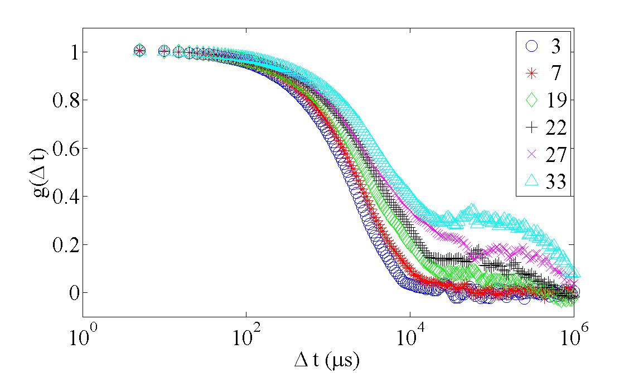
Fitting Exponentials
Single Exponential fit:
Double Exponential fit:

Slide 6
Cumulant Analysis
Obtain 1, 2, or 3 parameters to generate size distribution
First order (single exponential)
  One parameter (average time)
Second order
  Two parameters (average time and u2 related to width)
Third order
  Three parameters (average time, u2 related to width, u3 to skew)
Assumptions
  Gaussian distribution
Polydispersity Index
  Alternative to 2nd moment
  NOT PDI of polymer MWs
Notes:
http://www.people.vcu.edu/~ecarpenter2/DigitalCorrelator.htm

Slide 7
CONTIN/NNLS/Regularized
Variations on a theme: fit using sum of many exponential decays
Extract time scale distribution directly:
Data with fits
Results
Notes:
http://www.people.vcu.edu/~ecarpenter2/DigitalCorrelator.htm

Slide 8
CONTIN/NNLS/Regularized
Pros & Cons
  Result of fits are complete size distribution
  Methods are fairly sensitive to noise in G:
  Inverse Laplace transform is ill-posed problem
References, from s-provencher.com, include
  CONTIN: A general purpose constrained regularization program for inverting noisy linear algebraic and integral equations. Comput. Phys. Commun. 27, 229 (1982).

Slide 9
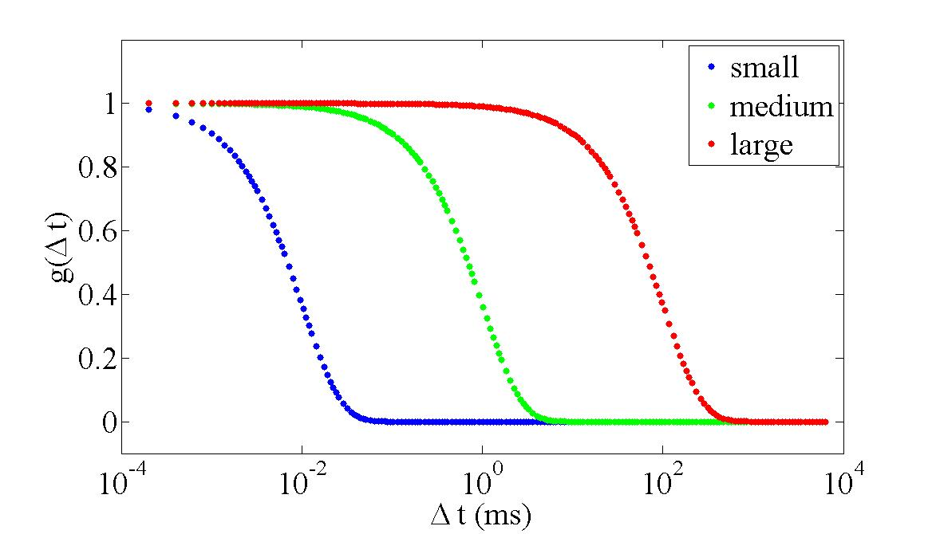
How Small Can DLS Measure?
Limited mainly by the shortest measurable timescale
In water; 532 nm; 90⁰
10⁻² ms → ~2 nm
Particle size measurement : spherical approximation

