Slide 1
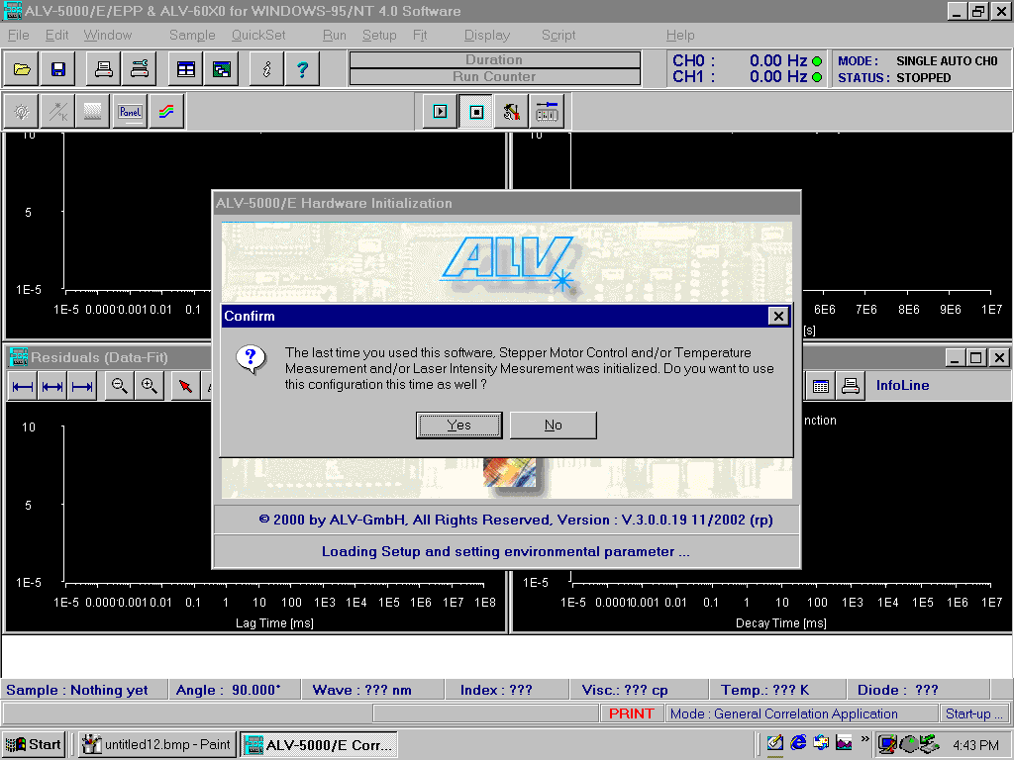
Start Screen: Select Yes

Slide 2
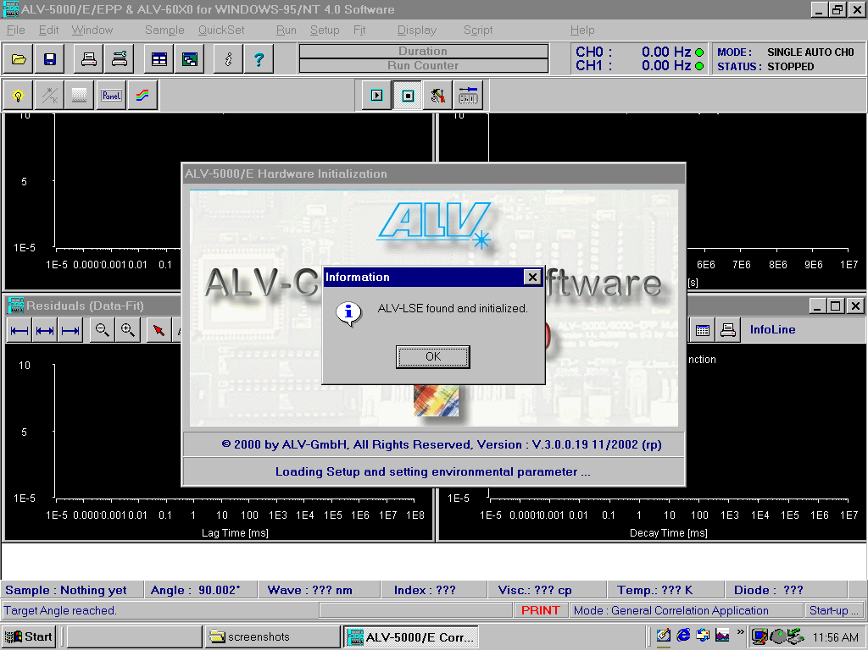
Software confirms communication with instrument

Slide 3
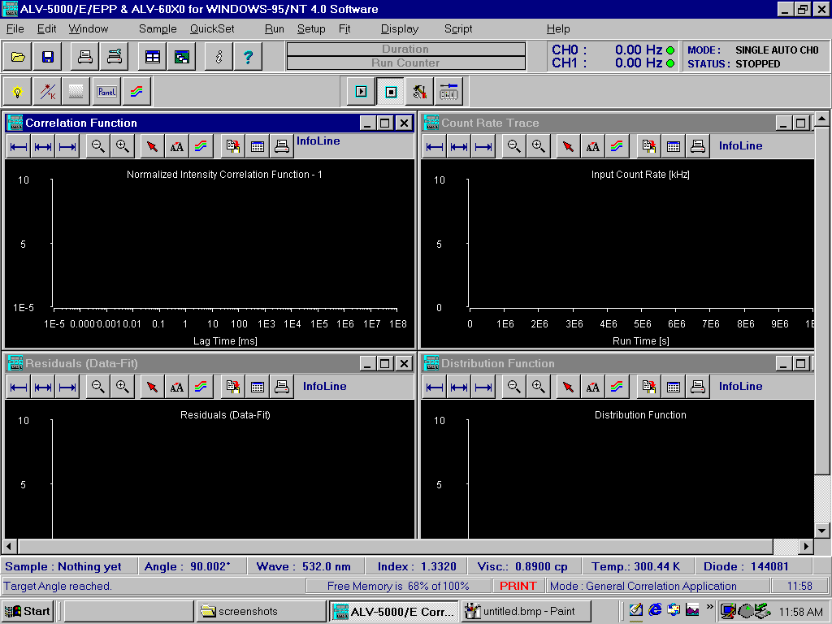
Bottom Row:
“Angle” is a control: 90 is default; double click here to move detector if desired
“Wavelength” indicates green laser: do NOT adjust
Default solvent is WATER, with “Index” and “Viscosity” as Indicated
“Temp” is an indicator, measured in the sample chamber
“Diode” is an indicator: control knob is on the laser line (see instructions)

Slide 4
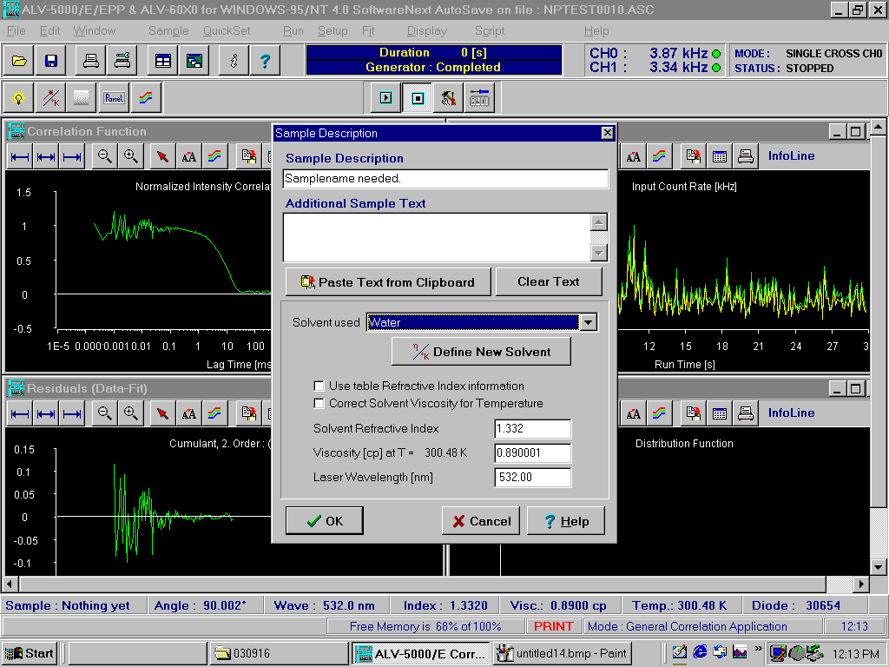
If your solvent is NOT water
Choose “Sample” either from Bottom Row or from Top Menu
Pop-up window shows solvent options, along with refractive index and viscosity, both required for size measurements.
Dropdown menu provides other options or choose “Create New Solvent”

Slide 5
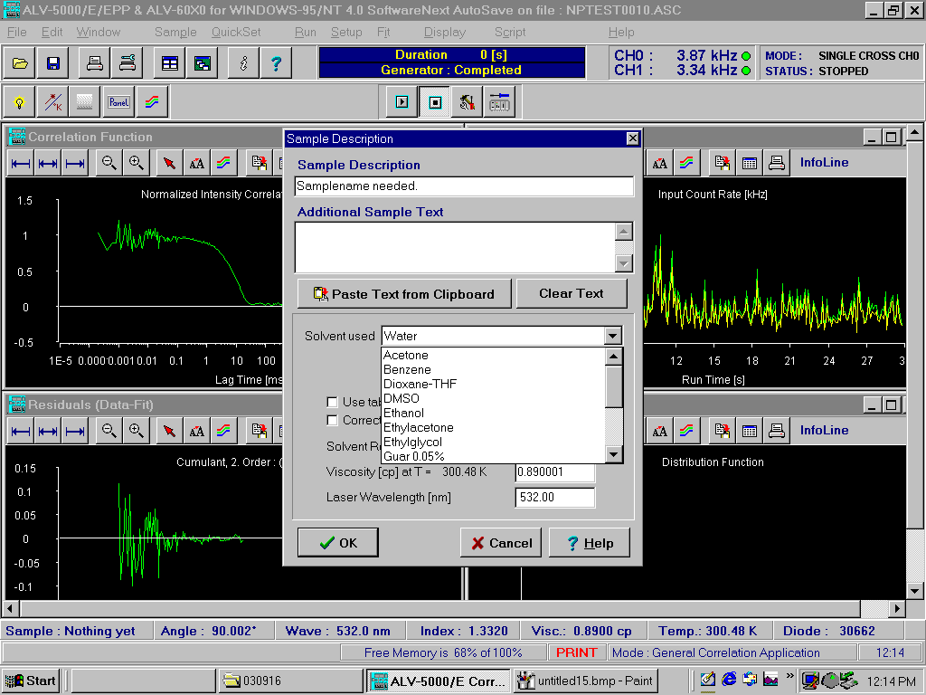
Dropdown menu provides other options
Or choose “Create New Solvent” and input:
Solvent name
Refractive Index
Viscosity

Slide 6
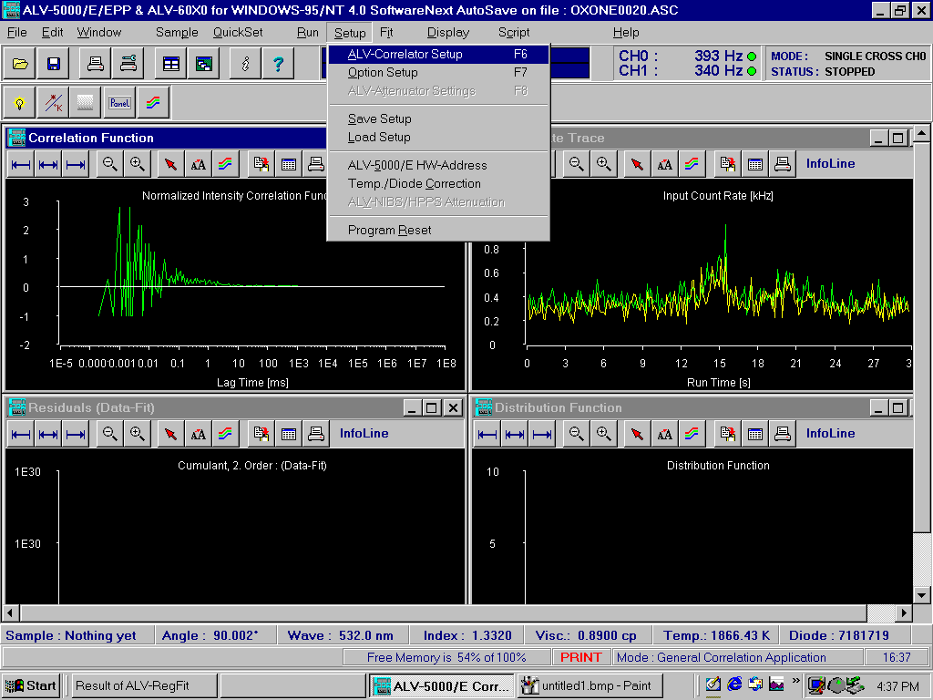
Setup Measurement Protocol:
Setup → ALV Correlator Setup

Slide 7
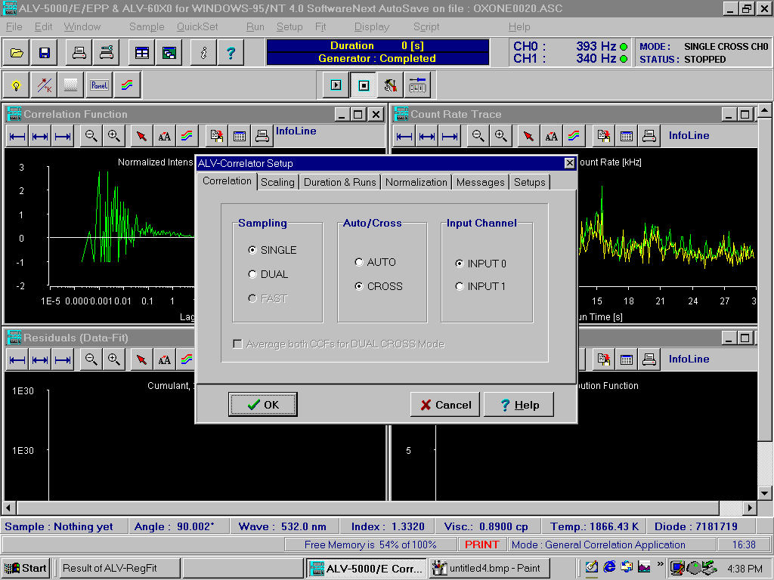
Popup Window, First Tab: Correlation
Choose “Single” and “Cross”

Slide 8
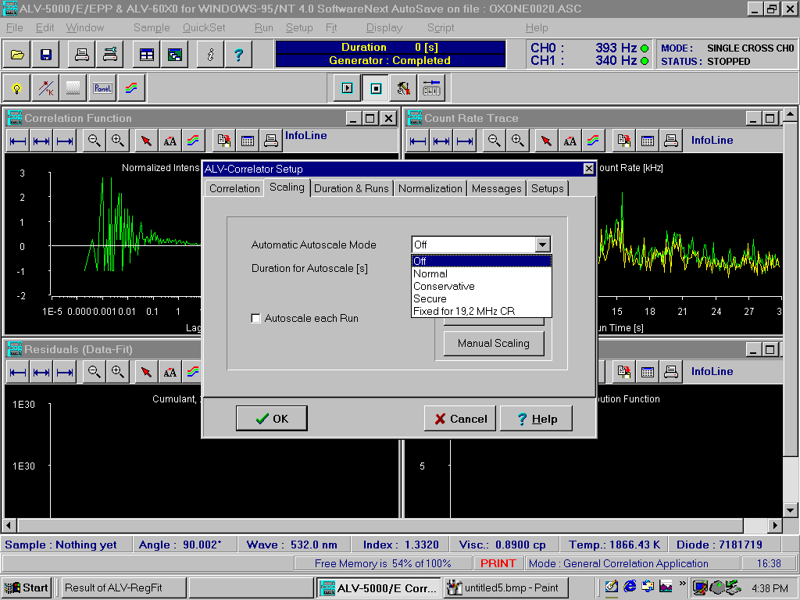
Popup Window, Second Tab: Scaling
Choose “Off” in Dropdown Menu

Slide 9
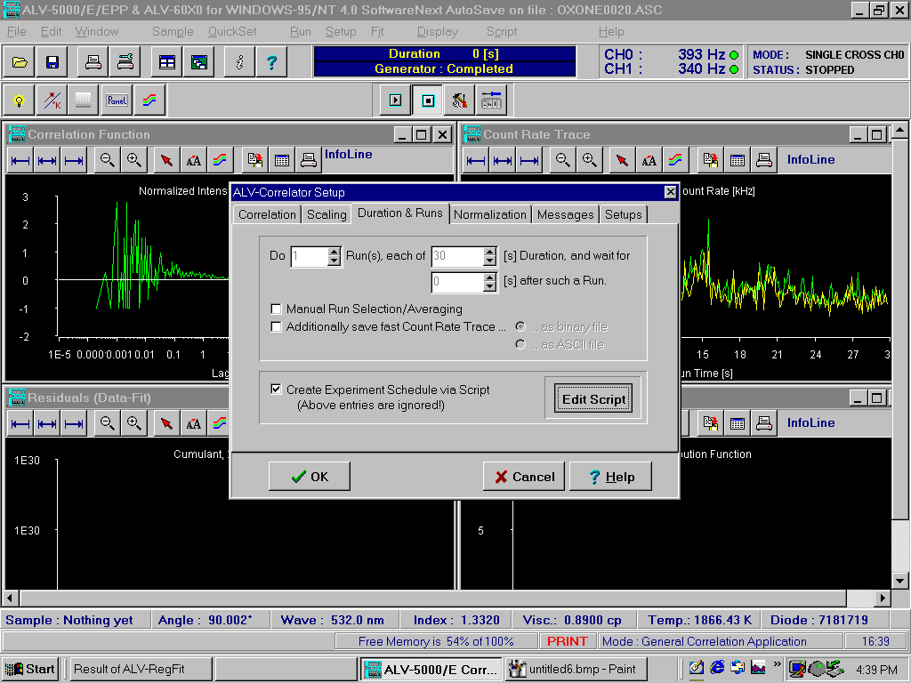
Popup Window, Third Tab: Duration & Runs
Select Box “Create Experiment Schedule via Script”
Then select “Edit Script”

Slide 10
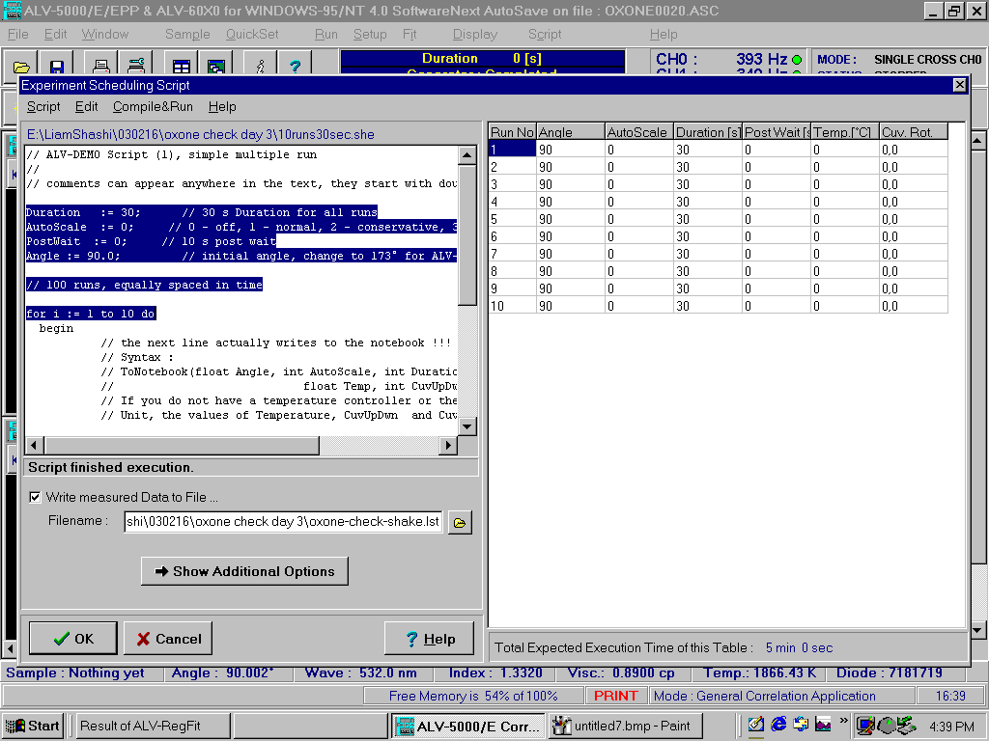
Script Popup:
Adjust highlighted Quantities as Desired
Recommendations:
Duration: 30 seconds
(adjust between 10 and 120 seconds, depending on sample)
AutoScale: 0 (for “off”)
PostWait: 0 (unless longer time course is desired)
Angle: 90 (default; adjust to 150 for backscattering)
For i=1 to xx number of runs

Slide 11
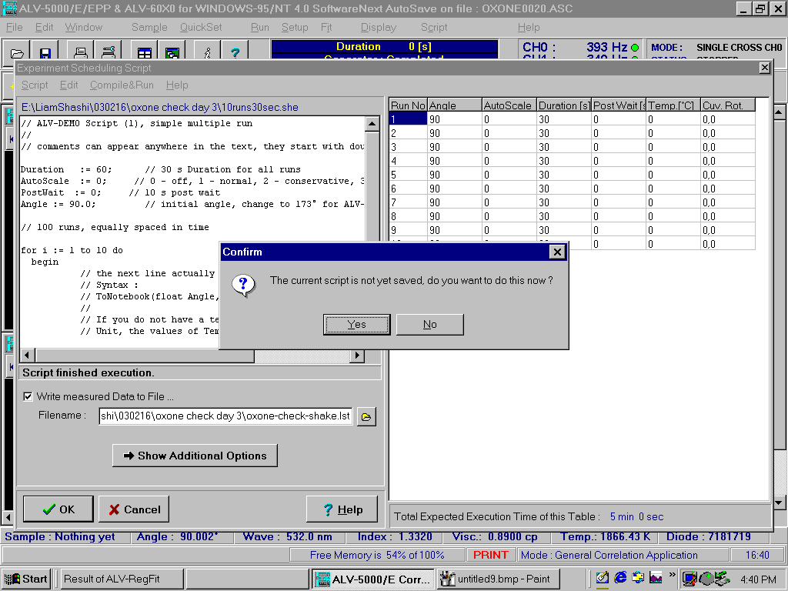
You may be prompted to Save your script
NOTE: Choosing YES saves your protocol/instructions only (i.e., the lookup table)
This step does NOT save any data that will be taken.

Slide 12
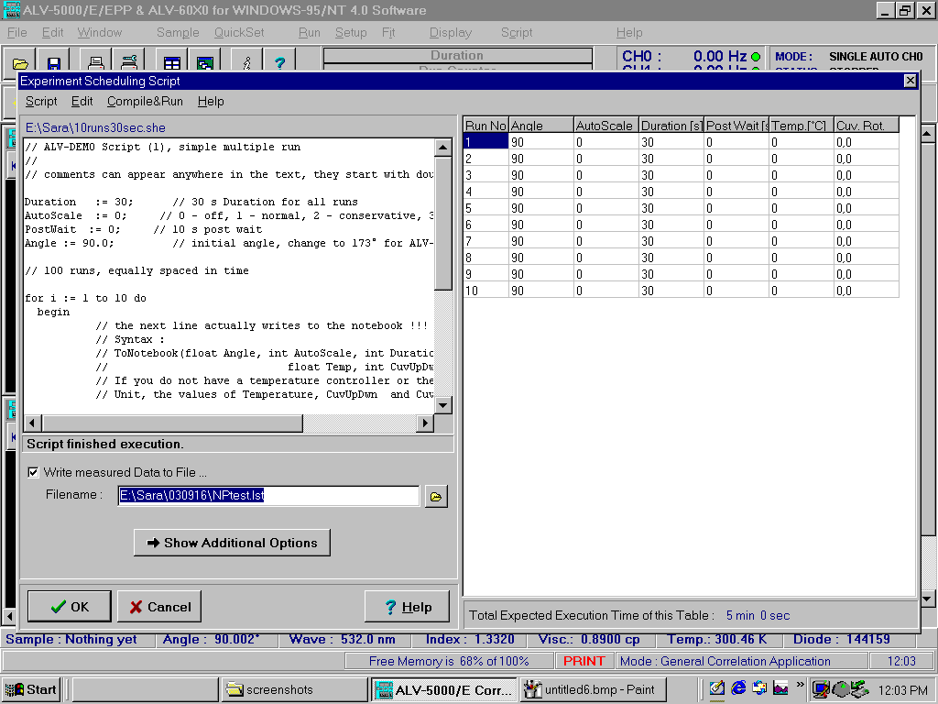
Choose a filename to save the data to be collected
Use the folder icon to navigate to your folder
The filename chosen will save a “summary” file of results for all runs in the script.

Slide 13
Choose “Compile & Run” to Populate Look-Up Table

Slide 14
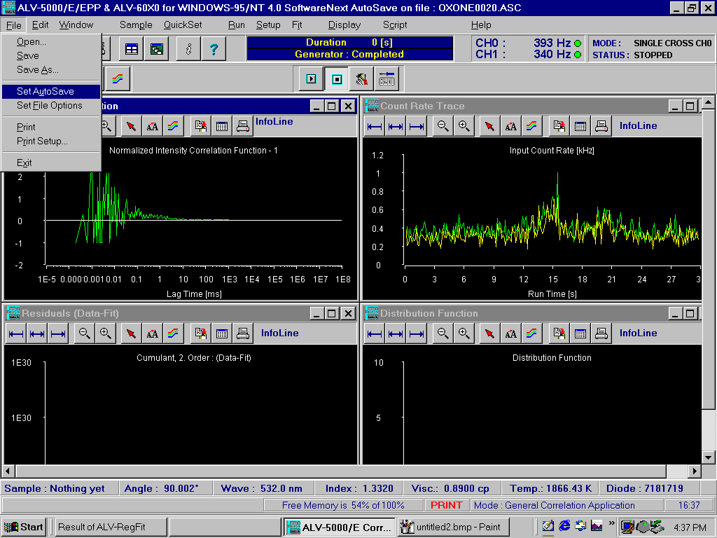
Choose File → Set Autosave
To save each run individually

Slide 15
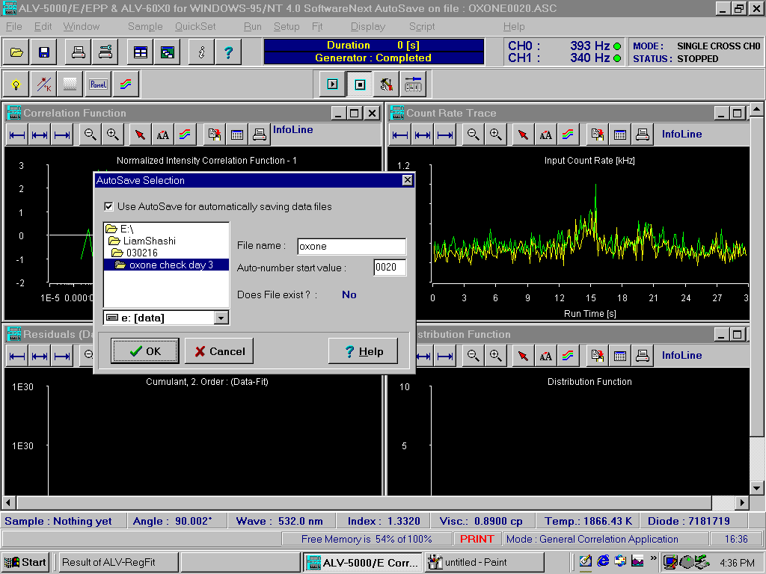
Select the Check box “Use AutoSave…”
Navigate to your folder if needed
Choose a Filename
A number will be appended to each file; 1 per run
e.g. for 10 runs, number will range from 0000-0009

Slide 16
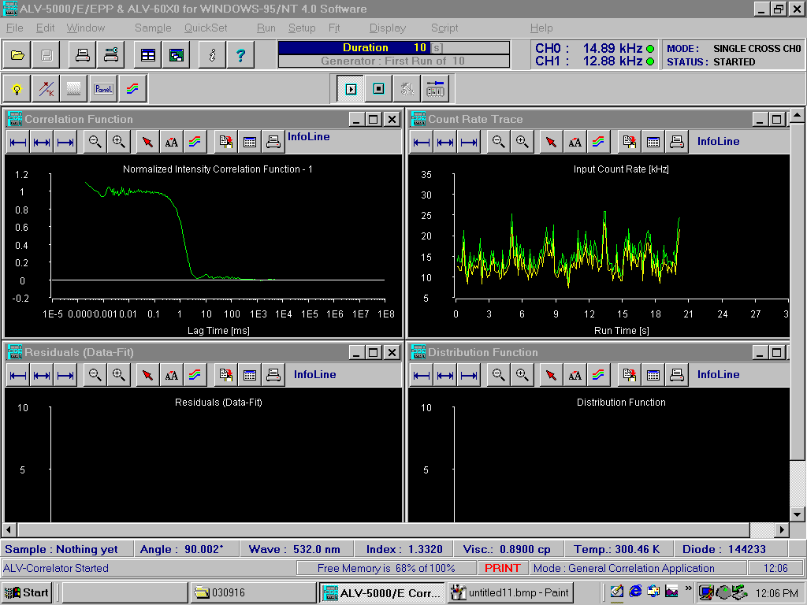
Intensity
Green Blinking – OK
Red Blinking – Overflow the Detector – need to lower the incident intensity

Slide 17
Correlation Data
Ideally: clean plateau

Slide 18
Intensity as a function of time
Beware intermittent spikes: might indicate dust particles

