Slide 1
Assembly & In/stability
786

Slide 2
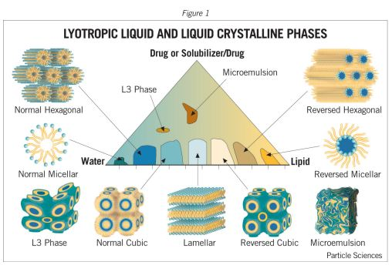
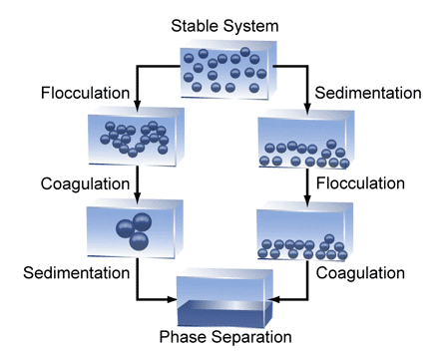
Overview
Thermodynamic Assembly
  Micellization
  BCPs and lipids
Thermodynamic Instability
  Creaming
  Sedimentation
  Aggregation

Slide 3
Overview
Unless thermodynamics dictate assembly, all roads lead to separation!
Complex fluids are metastable
LS is a great tool to assess stability

Slide 4
Micellization

Slide 5
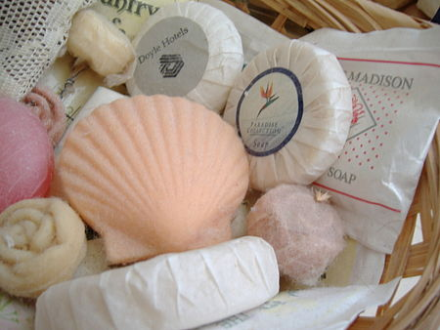
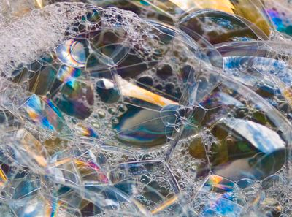
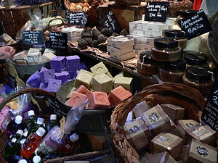
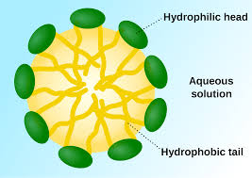
The Ebers papyrus (Egypt, 1550 BC) indicates the ancient Egyptians bathed regularly and combined animal and vegetable oils with alkaline salts to create a soap-like substance.
2 main ingredients!
Notes:
https://en.wikipedia.org/wiki/Soap
https://encrypted-tbn2.gstatic.com/images?q=tbn:ANd9GcR3zMql6EU-kk57thy7DYsUjX-cekAJDRNKNA2WPk-wh26BoM04QA
Bubbles: http://www.soaphistory.net/

Slide 6
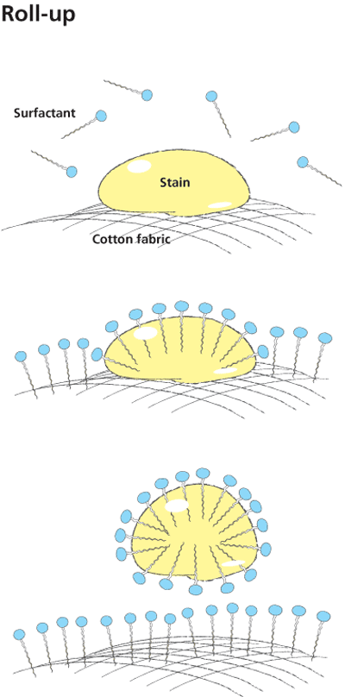
How does soap work?
Rinse away…
econutssoap.com
Notes:
http://econutssoap.com/wp-content/uploads/2011/12/roll-up-mechanism-credit-scienceinthebox.gif
http://27.109.7.67:1111/econtent/lipids-I/soap-detergent_clip_image003.jpg
https://encrypted-tbn0.gstatic.com/images?q=tbn:ANd9GcQMEB-tJOXABb-mVJ_QRMPjZJIXDsGiP47PgAlsH4Kz8i0M17psYg
So although strictly speaking just about any surfactant will do an adequate job at roll-up when studied as a nice scientific problem, most surfactants will be (a) poor stabilisers of the drops, (b) poor emulsifiers of the drops, (c) too attracted to the surface or all of the above. In other words, relying on roll-up is a recipe for disaster. Hence a focus on emulsification via HLD=0 or, for real sophisticates, finding "slow" polymeric surfactants that wrap around the rolled-up drop is going to be vital for effective cleaning.
FROM http://www.stevenabbott.co.uk/practical-surfactants/roll-up.php
See also https://www.surfactantassociates.com/

Slide 7
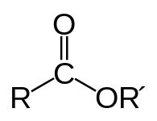
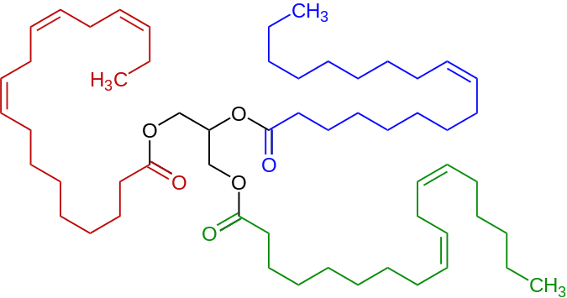
Saponifcation reaction = ester hydrolysis of salts
Ester Group
+ NaOH (lye)
Representative triglyceride found in a linseed oil, a triester (triglyceride) derived of linoleic acid, alpha-linolenic acid, and oleic acid.
Notes:
https://en.wikipedia.org/wiki/Ester
Fat + strong base = soap -- Fats are esters -- Base breaks the OR’ bond to form salts

Slide 8
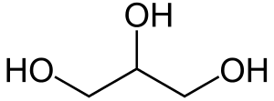
Ester Group
Na+
Na+
Na+
Glycerin
Representative triglyceride found in a linseed oil, a triester (triglyceride) derived of linoleic acid, alpha-linolenic acid, and oleic acid.
Notes:
https://en.wikipedia.org/wiki/Ester

Slide 9
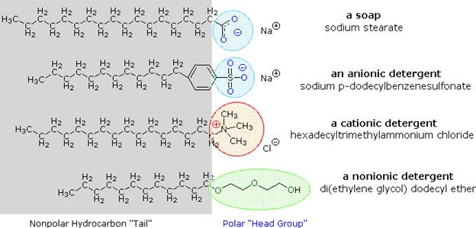
Result: Soap
Start with liquid oils/fats like glyceryl tristearatte
React with lye or sodium hydroxide strong base → Sodium stearate + glycerine (softener)
Sodium stearate = soap = surfactant sodium
Notes:
http://econutssoap.com/wp-content/uploads/2011/12/roll-up-mechanism-credit-scienceinthebox.gif
http://27.109.7.67:1111/econtent/lipids-I/soap-detergent_clip_image003.jpg
https://encrypted-tbn0.gstatic.com/images?q=tbn:ANd9GcQMEB-tJOXABb-mVJ_QRMPjZJIXDsGiP47PgAlsH4Kz8i0M17psYg

Slide 10
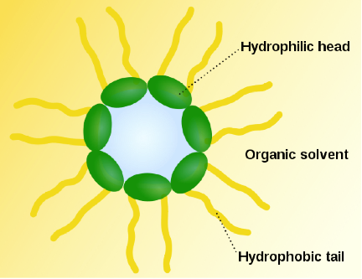
What differentiates surfactants?
Increasing concentration
Self-association leads to
reverse micelle formation
at critical micelle concentration
Measurable via:
conductivity, light scattering, surface tension, viscosity…

Slide 11
Dispersant critical micelle concentration
by conductivity measurements
BA ~ 10 ppm 4F ~ 100 ppm
Notes:
Fix the y axis negative exponents

Slide 12
Dispersant micellization
by conductivity measurements
BA ~ 10 ppm 4F ~ 100 ppm
Notes:
Fix the y axis negative exponents

Slide 13
Surfactants below/above the cmc
Low c
  Nothing to scatter from
  No size to measure
High c
  Number of scatterers grows
  Measureable size
CMC can determine how surfactants interact in suspension: self-assembly may reduce or facilitate interaction with other components.

Slide 14
Stabilization by adsorption
Adsorption isotherms corroborate LS particle characterization
2 dispersants: cmc ~ 10 and ~ 100 ppm in heptane
Each stabilizes asphaltene colloids below respective cmc
Hashmi, Firoozabadi. Soft Matter 7, 8384 (2011).

Slide 15
Interparticle Interactions

Slide 16
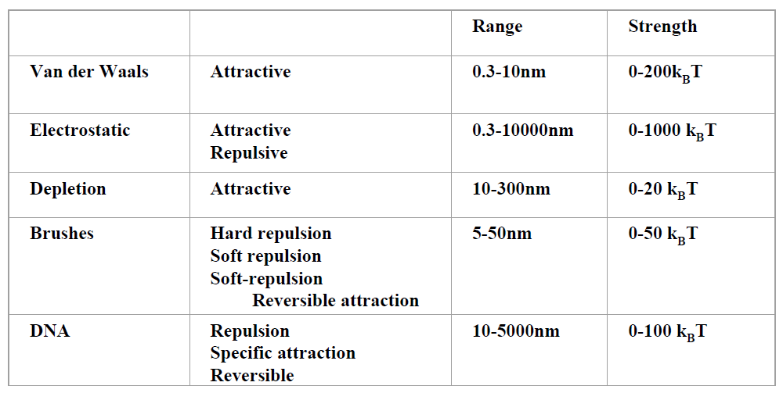
In/Stability & interparticle interactions
Universal
Repulsion Required
Brushes: short-ranged
Electrostatics: good candidate to explain stability
physics.nyu.edu/~pc86

Slide 17
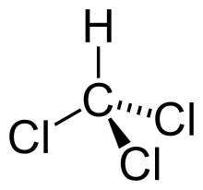
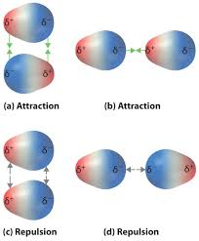
Van der Waals & Dispersion
Dipole-dipole and induced-dipole interactions
All material has some degree of polarizability
  Universal
  Attractive
Hamaker constant A
F ~ - A / r ⁶
NOTE: short range:
F ~ 1 / r ⁶
Notes:
https://saylordotorg.github.io/text_general-chemistry-principles-patterns-and-applications-v1.0/s15-02-intermolecular-forces.html
Chloroform has a fixed dipole moment
Acetonitrile also has a fixed dipole moment CH3CtriplebondN

Slide 18
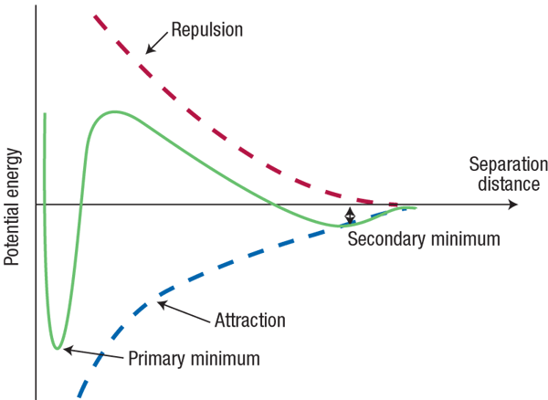
Inter-particle Potentials
U
if repulsion is electrostatic, DLVO theory describes U(r)
U_{max}
r
Irreversible aggregation →
→ Induced dipole-dipole van der Waals
Malescio Nature Materials 2, 501 (2003).
Notes:
http://www.malvern.com/LabEng/industry/colloids/dlvo_theory.htm
http://www.ncl.ac.uk/dental/oralbiol/oralenv/tutorials/electrostatic.htm

Slide 19
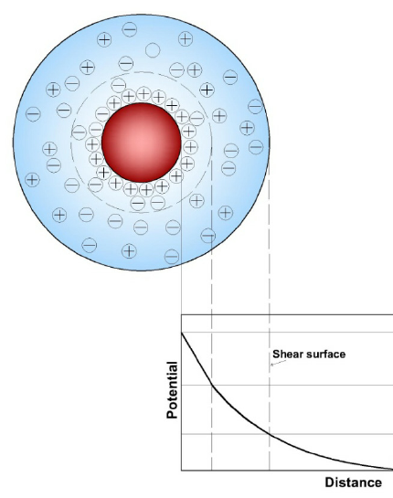
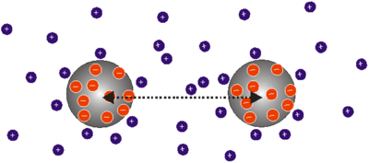
Electrostatics
Coulomb’s law
F = kq₁q₂ / r²
Thin double layers in aqueous systems
-
Double layer indicates range of electrostatic interactions
electrostatic interactions (1/r²) are longer-ranged than van der Waals (1/r⁶).

Slide 20
Size of the screening length
-
Aqueous suspensions
Thin double layers
Double layer indicates range of electrostatic interactions
Non-polar suspensions
Thick double layers
Electrostatic attraction is longer range in oil than in water
Notes:
https://www.researchgate.net/publication/236186356_Iron_Oxide_Nanoadsorbents_for_Removal_of_Various_Pollutants_from_Wastewater_An_Overview

Slide 21
Measurement Concept: Zeta Potential
Electric field : diffusion with drift
+
Drift velocity:
-
“Phase Analysis Light Scattering”
Analogous to Doppler shift, but with oscillating electric field
Initial position
Diffusive trajectory
Final position
Surface charge
Balance electrostatic force:
Against hydrodynamic force:
Electrophoretic mobility:
Related to surface charge:
Notes:
Force balance is f=qE=QeE = f=6 pi*eta*a*v → QeE=6pi*eta*a*v → v/E = Qe/6pi*eta*a
Mobility in the transport sense is always velocity dividing by the applied field

Slide 22
Electrophoretic mobility & Zeta Potential
+
-
+
+
+
+
+
+
+
+
+
+
Balance electrostatic and hydrodynamic forces:
Hückel Theory:
For low ionic strengths (apolar)
Smoluchowski:
For high ionic strength (aqueous)
Notes:
Force balance is f=qE=QeE = f=6 pi*eta*a*v → QeE=6pi*eta*a*v → v/E = Qe/6pi*eta*a

Slide 23
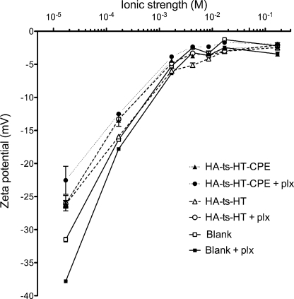
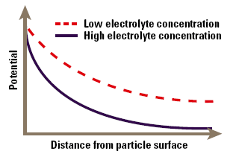
Effect of Ionic strength
Ions “screen away” electrostatic repulsion, thus reducing zeta potential magnitude
Rajapaksa TE, et. al. J. Biol. Chem. (2010)
Notes:
https://openi.nlm.nih.gov/detailedresult.php?img=PMC2911333_zbc0331026020003&req=4

Slide 24
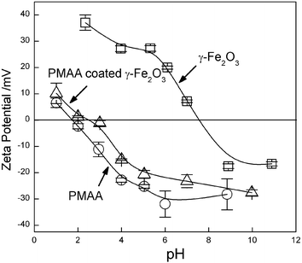
Point of Zero Charge
Adjusting pH by adding acid/base can induce protonation/deprotonation of the particle surface, thus changing the surface charge

Slide 25
Sedimentation

Slide 26
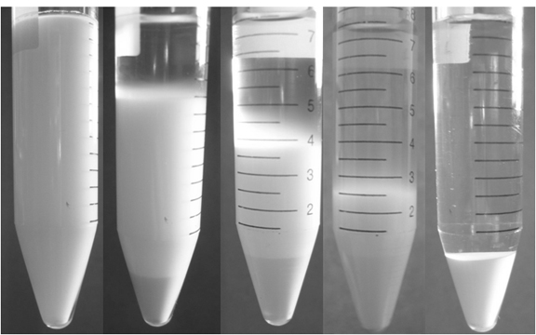
Hard sphere systems: linear front
1.57 µm radius silica spheres in water at Φ=0.05
t = 0 min t = 60 min t = 95 min t = 150 min t = 210 min
Notes:
Align pictures – P10805… 37, 52, 59, 641, 572

Slide 27
Hard sphere systems: linear front
Φ
a = 1.57 µm; silica particles in water
Sedimentation Velocity:
µm/s
Gravity
Density difference
Measured v ~ 2 to 3x slower than expected
Silica zeta potential:
ζ = -18.25 +/- 0.31 mV

Slide 28
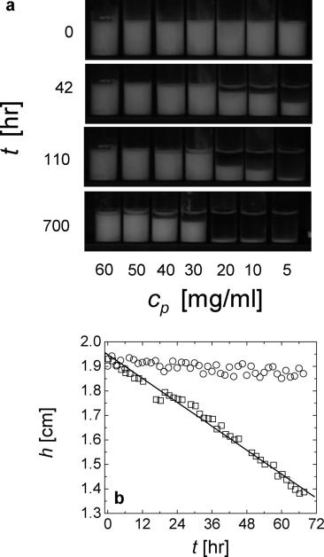
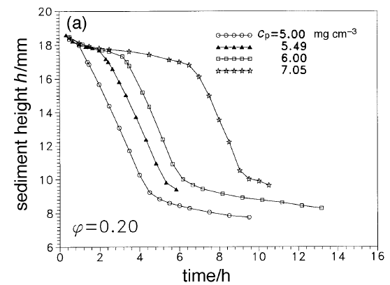
Gelling systems: sudden collapse
Poon et. al. Faraday Discuss. 112, 143 (1999).
Lietor-Santos et. al. Langmuir. 26(5), 3174 (2010).

Slide 29
Unstable particles aggregate & settle
NP formation
Aggregation
FAST Sedimentation
FAST
Separation
Sedimentation speed ~ (aggregate size)²

Slide 30
Stable particles; no aggregation
NP formation
Aggregation
SLOW Sedimentation
SLOW Separation
Sedimentation speed ~ (aggregate size)²

Slide 31
Growth & settling often simultaneous
Separation of time scales
Sedimentation
Intensity (kcps)
Growth
Time (hours)

Slide 32
Lab Tasks Day 2
3 surfactants
  Prepare dilutions on log scale from stock
  Run initial measurements
  Prepare additional samples to ‘zoom in’ on cmc
CNTs in suspension
  Assess growth and settling over time
  Depending on sonication/sample preparation
SLS on CNTs and PS spheres

