Slide 1
Static Light Scattering Part 2: Solute characteristics
786

Slide 2
What can light scattering measure?
For a solute in solution, light scattering can determine:
Molecular Weight, M
Radius of gyration, R_{g}
Second virial coefficient, A₂
A typical application is the determination of the weight average molecular weight M of a macromolecule... the radius of gyration R_{g} or the form and structure factor. By measuring the scattering intensity at various concentrations, the second virial coefficient A₂, can be calculated. Special analysis techniques such as the Zimm or Guinier Plot can be used to obtain results from the measured data. – lsinstruments.ch
Notes:
Notes: With the controlled parameters of an experiment, it is possible with a light scattering measurement to retrieve the molar mass (M), size (r_{g}), second virial coefficient (A₂), and translational diffusion coefficient (D_{T}) of a solute in solution. One of the tremendous advantages of light scattering over almost any other method is that these properties can be measured in solution in a non-invasive manner.
Depending on the type of experiment, a light scattering measurement retrieves different aspects of the above-mentioned properties. For example, in an unfractionated sample, or a batch measurement, the measured molar mass is averaged over the weight distribution of the sample, while the size determined in such a measurement is an average over the radius squared. For fractionated samples, the unaveraged mass and size distributions can be obtained, and from this, information about conformation can be determined.
Also, the first three quantities, M, r_{g}, and A₂, are measured via a technique called either classical, static, or Rayleigh scattering. In this technique, the time scale of the measurement is long compared to rapid fluctuations in scattered intensity due to molecular motion. These fluctuations are hence averaged out. The focus of today’s lecture is Rayleigh scattering. It is also possible to measure the fast (nanosecond) fluctuations of the scattered intensity in a technique known as dynamic light scattering, photon correlation spectroscopy, or Quasi-Elastic Light Scattering (QELS). This type of measurement determines the translational diffusion coefficient for the solute, which is sometimes converted to an effective hydrodynamic radius (r_{h}) based on the assumption that the solute is a sphere.

Slide 3
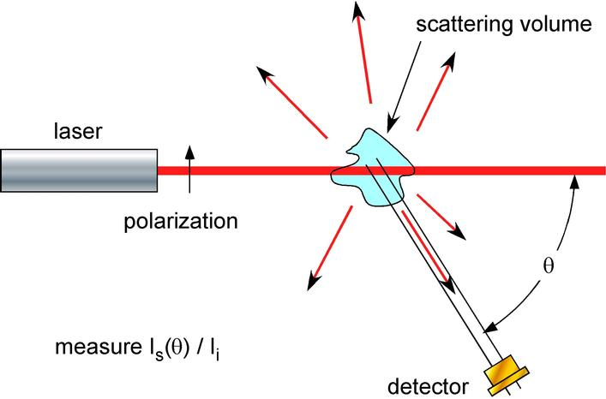
Background toluene and solvent also scatter light due to density fluctuations

Slide 4
What does I(q) tell us?
Form factor P(q)
Information about individual particles
Structure factor S(q)
Information about “particle packing”
Dependent on pair-correlation function
Both individual solute molecules/particles and their arrangement in solution contribute to I

Slide 5
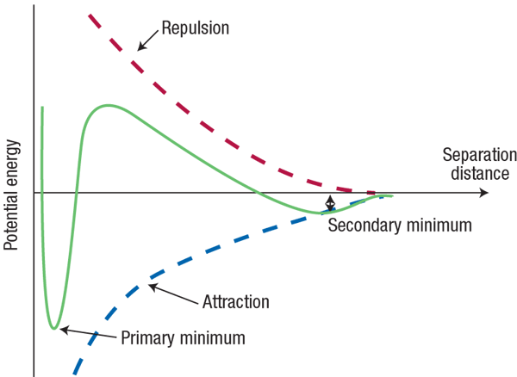
Structure Factor S(q)
Pair correlation function depends on interparticle interaction
U
U(R)
U_{max}
r

Slide 6
Second virial coefficient
Also related to interparticle potential
From thermodynamics: Deviation from ideal gas law based on interaction between 2 particles
U(R)

Slide 7
Pair correlation g(r) and Structure factor S(q)
S(q)
g(r)

Slide 8
Pair correlation g(r) and Structure factor S(q)
S(q)
g(r)

Slide 9
Pair correlation g(r) and Structure factor S(q)
S(q)
g(r)

Slide 10
Understanding SLS data
SLS simultaneously measures I, Kc/R & R_{H}
R_{H} is hydrodynamic radius, same as from DLS
c is concentration of solute
K is a material constant; n = refractive index
Kc/R is called the “Rayleigh Ratio,” where R is the “excess scattering” from the solute alone

Slide 11
Rayleigh Ratio
The instrument measures this quantity as a function of angle
It can be derived that:
Where M = molecular weight, B₂ = second virial coefficient
From form factor
c
From structure factor

Slide 12
Zimm Plot
Simplifications:
when q → 0 this becomes linear!
M comes form intercept and B₂ from slope
c
c

Slide 13
Zimm Plot
Measure Kc/R for multiple concentrations at multiple angles
Plot tool extrapolates q→ 0 and c→ 0
Traces represent different c’s
Kc/R
What if you don’t know K and/or c very precisely?

Slide 14
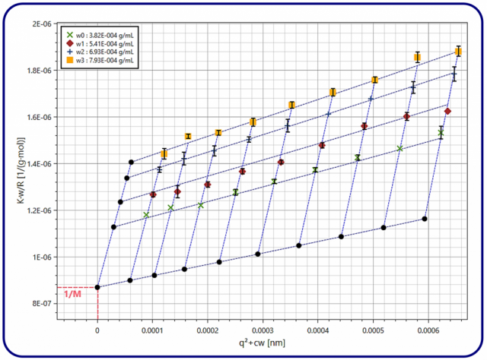
– lsinstruments.ch

Slide 15
Zimm Plot
c
Extrapolations:
c→ 0
c
q→ 0
Intercept = 1/M
M = weight-averaged molecular weight

Slide 16
Note: Form Factor P
Geometrical Consideration: integral over the particle/molecule volume considering position of each point within the particle/molecule
Also equal to
Which is convenient when q and R are known (typically use R from measurement at 90 degrees)

Slide 17
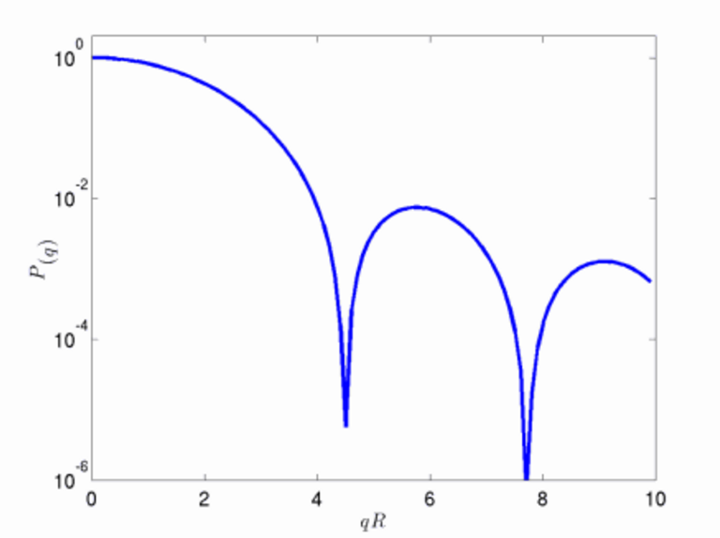
Form Factor P for a Sphere

Slide 18
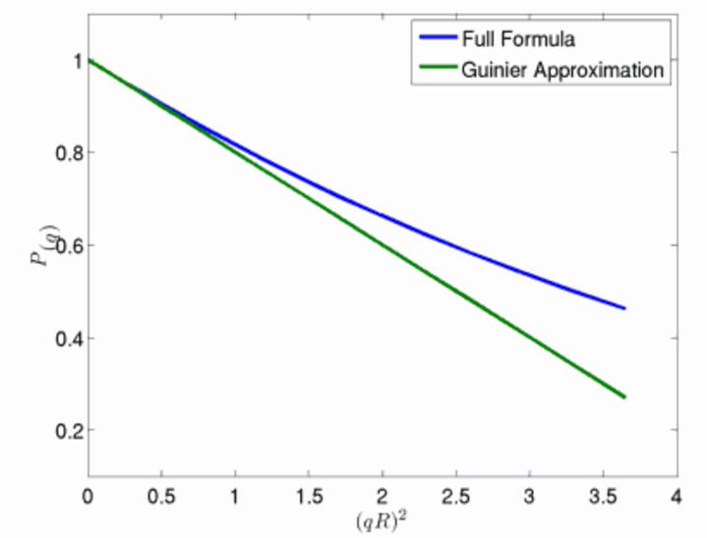
Form Factor P
Guinier Approximation:
Initial slope gives
radius of gyration
Don’t need to
specify c or dn/dc!

Slide 19
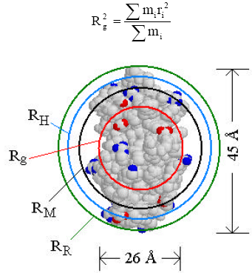
Radius of gyration & shape factor
Radius of gyration = mass distribution about the center of mass
P = R_{g} / R_{H}
Shape factor for…
Sphere = 0.67
Ring = 1
Notes:
the mass distribution about the center of mass, weighted by the square of the distance from the center of mass.

Slide 20
Lab Tasks
SLS measurement on polymer standard
SLS on BSA protein (?)
Use Plot & Fit software to assist with Zimm plots and extraction of parameters – thank you Sharon!

